Slide 1
Student Learning Objectives
Teacher Orientation
Texas
Notes:
Orientation notes in bold text are direct quotes for trainer comments to read to participants.
Notes in regular font are background and guidance for trainers to know and use in delivering the training.
Italicized notes on slides should be replaced with specific information each training such as trainer names.
Slides for breaks and lunch are at the end of the PPT to copy and insert where needed depending on the pacing and organization of the orientation.
Some slides regarding the conference (BOY, MOY, EOY) are written with the administrator in mind for those who may be training assistant principals. They are optional for teacher orientation and are labeled in the trainer notes. In addition, they are identifiable by the pale blue background on the slide.
Welcome participants
Below are resources that participants will need during the training. These are linked in the Resource tabs and under Orientation at texasslo.org.
Plan ahead to prepare how you, as the trainer, will share materials with participants, based on whether you are doing virtual or in person training. Planning resources for how to share the materials virtually are available under the Trainer tab on the website, texasslo.org.
Under Resources tab:
https://texasslo.org/Resource_files/resources/SLO_Form.pdf
https://texasslo.org/Resource_files/resources/SLO_Success_Criteria.pdf
https://texasslo.org/Resource_files/resources/SLO_Rating_Rubric.pdf
https://texasslo.org/Resource_files/resources/Student_Growth_Tracker.xlsx
Background information for trainers:
If you have participants who used Texas SLO prior to 2021, they may have been trained on a similar but different process. Many of your participants will not have prior experience. You may or may not need to share differences depending on your audience. Overall structure is the same (Skill Statement, ISP, TSP, etc.) but level of validity and reliability is different. Emphasize the new BOE requirement of 5 data points in order to be able to determine end of year student skill levels, that map back to the TSP.
Below are key differences between the prior version of Texas SLO and the update version which was rolled out in 2021 for trainer background information:
What is different in the 2021 updated version?
Emphasis as a valid and reliable measure of student growth
Multiple data points used to determine ISP/TSP levels
BOE required (at least 5 data points) to determine EOY Skill level
What is the same between the 2021 updated version and the prior version?
SLO Skill Statement
Initial Skill Profile
Targeted Skill Profile
Reflective process that can lead to teacher professional growth as well as student growth

Slide 2
About us…
Presenter(s) Name Here
2
Notes:
1 min.
Introduce trainers (adapt or skip this slide as needed if delivering at the campus level by well-known leaders)

Slide 3
Welcome!
In the bottom left corner find the microphone icon. If you aren’t already muted click the icon once to mute yourself.
In the bottom left corner of your screen, please turn on your camera if you are able.
Locate your participant video and click on the “more” icon to rename yourself. Include first name, initial of last name, and current role. Example: Theresa M, Principal
3
Notes:
SKIP THIS SLIDE FOR IN PERSON TRAINING
Review Zoom courtesy and expectations.

Slide 4
Google Folder Materials
*insert screenshot and guidance on how to access materials*
Notes:
Modify as needed with information for participants to access the SLO form and any other materials shared online.

Slide 5
About you…
Share a time when you (or your students or children) demonstrated growth.
5
Notes:
4 min.
Use the slide as an icebreaker. Format depends on size of group and mode of delivery.
Suggestions for processing this activity:
In person (Process activity at table group.)
Virtual w/ Nearpod (Process activity via Collaborate board.)
Virtual without Nearpod (Process activity via Google Jamboard, verbally in breakout rooms, or in chat for a very small group.)
Wrap up whole group and allow 2 volunteers to share an example that stood out in their small group.

Slide 6
Objectives
Participants will:
Understand the SLO process as a valid and reliable measure of student growth.
Review all 3 phases of the SLO process through the student growth lens.
Practice writing and editing all steps in the SLO process.
6
Notes:
2 min.
Process objectives for the session per the slide.

Slide 7
Framing Questions
How do we know if students are growing in their knowledge and skills?
What evidence will we use to determine students’ beginning skill level, the progress they make throughout the year, and determine their end of year skill level?
Notes:
2 min.
Trainer talk:
Take a moment to consider evidence participants/teachers might use to determine progress throughout the year and track it. Share in the chat (virtual delivery) or share at your table (in person) your response to one of these questions, so we can learn from each other.
Other options for virtual delivery:
Collaborate board in Nearpod
Jamboard in Zoom
Chat in Zoom
Breakout rooms not recommended due to time constraints.

Slide 8
SLO Process – 2
Highly structured
Multiple data sources for all three phases of SLO process
Student work as evidence
An alternate student growth measure, based on body of evidence of student work, instead of a pre-test/post-test
Appraiser approval of all three phases of SLO is critical (which means appraiser training is critical)
8
Notes:
2 min.
Trainer talk:
The Student Learning Objectives process is designed to be an alternate student growth measure that is different from pre-test/post-test. SLOs are an option if a district wants an alternative to pre-test/post-test. SLOs are based on student work designed to measure student skill as it relates to the skill statement. Student work is the evidence of growth, rather than the comparison of pre/post test results.

Slide 9
Student Growth: Using Tests vs. Using a Body of Evidence of Student Work
SLOs
Pre-test/Post-test
Based on a foundational skill
Based on a body of evidence of student work aligned to the skill
Student work from throughout the school year
Multiple data points
Typically based on larger scope of material
Based on how students perform on a test, not on student work
Comparison of beginning and end of year tests
Two data points
Notes:
2 min.
Trainer Talk:
Pre-test/post-test is also a valid student growth measure and can be used as the Student Growth Measure (SGM) for purposes of TIA. However, SLOs are a different option that is NOT based on just two tests.

Slide 10
Connection to Teacher Growth
Reflective process:
On which assignments did students demonstrate the most growth?
How might this reflect instructional practices being used?
How did differentiated student supports align with demonstrated student growth?
Use evidence, reflection, and coaching to make necessary instructional pivots.
10
Notes:
2 min.
Trainer talk:
While the focus of SLOs is as a valid and reliable measure of student growth, the SLO process still is about teacher growth. Think of it as teacher growth through the lens of student growth.
What kind of assignments yielded the highest student growth?
What instructional practices were in place during times of the highest student growth?
Do some students demonstrate higher growth with some instructional practices, while other students demonstrate more growth with other practices?
The idea is to ground our thinking about teacher growth in the evidence we have for student growth.

Slide 11
Highly Structured Process
Level of detail in SLO Skill Statement
Evidence based Initial Skill Profile (ISP)
Evidence used to map students to ISP
Evidence used to set Targeted Growth Goals for each student via the Targeted Skill Profile (TSP)
All of the above approved by trained appraisers at BOY conference
BOY, MOY, and EOY conferences
Body of Evidence used at EOY to determine each student’s EOY Skill level
11
Notes:
1 min.
Trainer talk:
Take 30 seconds to reflect on the bullets of this slide. Some of the acronyms may be new to you and we will be learning about each of them. (pause)
The Texas SLO process is highly structured. There are other version of SLO processes out there, so it is important to distinguish exactly what we mean when we say “SLOs.” There may be districts that are using what they call SLOs, but really what they are doing is a pre-test/post-test system, and not following the process of:
a) SLO Skill Statement,
b) Initial Skill Profile,
c) Targeted Skill Profile and setting targeted growth goals for each student based on multiple data points,
d) A body of evidence of student work used to determine EOY growth,
e) Strong BOY, MOY and EOY SLO conferences,
f) Trained appraisers approving each step of the SLO process.
The detail and structure of the Texas SLO process, when implemented accurately, yields valuable information on student growth.

Slide 12
Body of Evidence (BOE)
What constitutes a valid BOE?
How aligned is each piece of evidence to the Skill Statement?
How will the BOE be tracked?
Do student work samples measure the skill named in the SLO Skill Statement?
May include but should not be limited to tests
Is there a high degree of alignment to Skill Statement?
12
Notes:
1 min.
Trainer talk:
The questions on the slide are important considerations when planning for and building the Body of Evidence. Take a few seconds to read through these questions. (pause)
The understanding that a Body of Evidence is used to determine student growth, rather than a test, is a key point in the Student Learning Objective process. Student work samples that are a part of the BOE should be designed in such a way that they actually measure the foundational skill that is the focus of the SLO. Note that student work samples may include tests (or specific items from a test) that measure the skill, but samples should not be limited only to tests. Other samples of student work that show mastery can and should be a part of the Body of Evidence.

Slide 13
Core Idea
The Student Learning Objective process is an evidence-based measure of student growth.
Notes:
1 min.
Ask a participant to read this Core Idea aloud.
Pause for a moment to allow participants to reflect on this Core Idea.

Slide 14
Growth vs. Achievement
Downwards arrow indicates change over time
Advanced
Proficient
Upwards arrow indicates change over time
Start of the School Year
End of the School Year
14
Notes:
3 min.
This slide will display differently if you are using Nearpod so be aware when you are preparing for training.
Animated slide:
Start with the blank graph. On the graph the Start of School Year is reflected on left and End of School Year on right. Notice the “proficient” line.
Click to show the first group of students on the top right. Notice the group of student on the top right. At first glance you see that they ended the year above proficient.
Click to show the second group of students on the bottom right. It looks as though they didn’t do so well, since they ended the year below proficient.
Click to show where the first group actually started the year. As it turns out, this group lost some ground over the course of the year.
Click to show where the second group of students started the year. It turns out that this group showed significant growth over the course of the year, compared to their skill level when they started.
The heart of SLOs is about student GROWTH, not necessarily achievement.

Slide 15
Growth vs. Achievement – 2
Pre-set grade level expectations for all
Student Growth Measures
15
Notes:
1 min.
Trainer talk:
Pre-set grade level expectations for all students is not the same as student growth measures. Student growth measures document the students’ skill levels prior to instruction and track the growth in skill level when the student receives instruction. The effectiveness of instruction will impact the level of growth that a student experiences in the specific skill or skills being measured.

Slide 16
The SLO Perspective
The goal of a teacher is to maximize the potential of every student in the classroom.
Student growth is the best indicator of whether teachers are reaching that goal.
Notes:
1 min.
Trainer talk:
This slide brings us back to the idea that we are focusing on growth, and also underscores how we can get at teacher growth: by focusing on student growth.

Slide 17
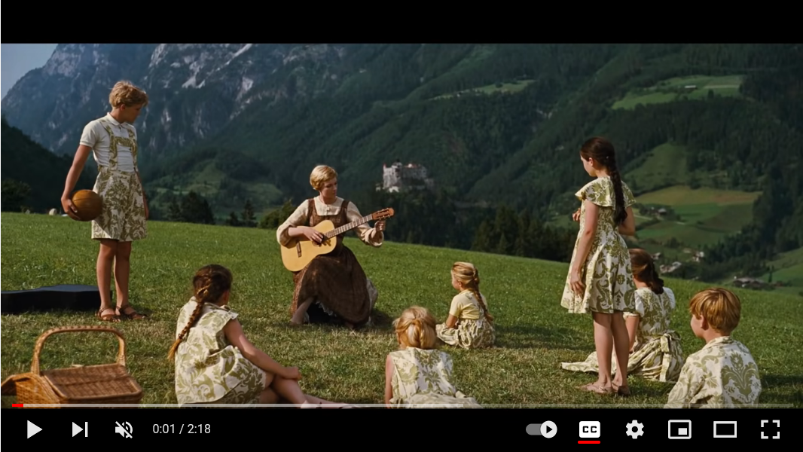
Video
17
Notes:
https://youtu.be/drnBMAEA3AM
Trainer talk:
This clip is from the movie, “The Sound of Music”. As you watch, consider what connections you see to the SLO process.
Show the clip. Give people some time reflect on how this clip connects to the SLO process.

Slide 18
Make a Connection
How does this clip from the “The Sound of Music” connect to the SLO process?
18
Notes:
5 min.
Allow participants to share connections that they make between the video clip and the SLO process.
Suggestions for processing:
In person (process activity at table group)
Virtual w/ Nearpod (process activity via Collaborate board)
Virtual without Nearpod (process activity via Google Jamboard, verbally in breakout rooms, or in chat for a very small group)

Slide 19
Sound of Music Debrief
Foundational Skill
“When you sing it begins with Do-Re-Mi”
Maria knows their skill level at beginning of the task and adjusts instruction
Multiple sources of evidence
Monitors progress
All about growth
Meets them where they are in skill level
Gradually increases difficulty of task
19
Notes:
2 min.
Hopefully participant comments and connections align with these key points. Call participants by name who touched on these points during the group share out. Add to the commentary as needed to ensure these connections are made.
Foundational Skill
Maria focuses on the skill of learning the notes This was a foundational skill identified in the clip.
Multiple sources of evidence Maria has them repeat the practice multiple times.
She knows their skills Maria observes and identifies what they can and can’t do at the beginning of the clip
Monitors progress Maria includes a role for each child and observes how they are applying the knowledge
All about growth More than a specific bar of achievement, the focus is learning the notes, and combining them to create music
Meets them where they are in skill level Instruction/coaching begins at the students’ point of need.
Gradually increases difficulty of task As skills increase, coaching and challenges increase to maximize growth.

Slide 20
Core Idea – 2
To maximize growth, we must know specifically which skills students do or do not have at the beginning of the year.
Notes:
1 min.
Take a moment to read this core idea out loud. Then pause for a few seconds and ask participants to jot down anything that comes to mind regarding this Core Idea.

Slide 21
SLOs are…
An accurate, evidence-based process to measure student growth
A concentrated look at instructional impact
Focused on a foundational skill of the course
Evidence-based
A means to teacher growth
Via focus on student growth
Reflect, assess, adjust
Notes:
1 min.
This slide reiterates and reinforces key points about SLOs. Emphasize the evidence-based language and name that the evidence is the student work.
Student Learning Objectives are:
An accurate, evidence-based process to measure student growth.
A concentrated look at instructional impact on student learning
Focused on a foundational skill of the course or class
Evidence-based
A means to teacher growth (The focus is on student growth and as teachers reflect, assess and adjust, their skills develop over time.

Slide 22
Six Big Questions of the SLO Process
How will I guide these students towards growth?
Who are my students?
What is the focus of my SLO?
Did students grow and what did I learn from this process?
Are students progressing towards these targets?
What are my expectations for these students?
Notes:
2 min.
Ask participants to work individually to put these in chronological order based on the order in which each question will be considered as a teacher considers the SLO process (not order of priority or importance) .
In person, the participants can use physical cards prepared ahead of time by the trainer.
Virtually, the participants can write them on post its and number them.

Slide 23
Correct Order of SLO Key Questions
What is the focus of my SLO?
Who are my students?
What are my expectations for these students?
How will I guide these students towards growth?
Are they progressing toward their targets?
Did students grow and what did I learn from the process?
Notes:
2 min.
Share the correct order. Point out that in order to determine where your students are with respect to the foundational skill (“Who are my students?”) you must have a foundation skill in mind first. The SLO 6 Big Questions can be found on p. 2 of the Teacher Orientation Manual.

Slide 24
Why isn’t “Who are my students?” first?
This isn’t about sorting the cards for order of importance, it’s about sequencing so that we maximize student growth.
We cannot determine where our students are with respect to a foundational skill, without determining what the foundational skill is first.
24
Notes:
1 min.
Read the title of the slide and the bullets aloud. Pause briefly for participants to process.

Slide 25
Reflections
What are your key takeaways from this section of today’s session?
Notes:
3 min.
Have participants spend two minutes in silent writing in their Participant Manual capturing their key takeaways from the opening section of the training.

Slide 26
Key Takeaways
SLOs:
Are a means to measure student growth
Are designed to help educators become more deliberate and evidence-based in their practices
Support both student and teacher growth
Provide a process to measure student growth based on relevant evidence of student work
Notes:
1 min.
Trainer talk:
These are some of the key takeaways that we noted…

Slide 27
Structure of the Training
Model/Activity/Your Turn
Key Ideas
Success Criteria
Exemplars/Non-exemplars
Practice creating your own
Core Ideas
Key Takeaways
Flexibility and Questions
27
Notes:
2 min.
Trainer talk:
Throughout the training we will use these structures.
Model/Activity/Your Turn The trainer will model the process then you as participants will have a turn.
To clarify the process you will see:
Key ideas
Success Criteria so that we know exactly what is expected.
Exemplars/Non-exemplars to help pinpoint common areas and how to coach them up.
You will:
Practice creating your own SLO
Core ideas to focus on the specifics
Key Takeaways as we reflect on our learning
We will practice flexibility and have opportunity for questions
Active participation is key. We will be learning, seeing exemplars, editing non-exemplars to make them better, and writing your own documents from scratch. The best way to coach teachers on the SLO process is to have campus leaders go through the full process-start to finish-on their own. While school leaders won’t need to be writing SLOs themselves in the field, you will need to approve what teachers submit, and be able to coach them accordingly, so we ask that everyone engage with the work of creating a full SLO themselves.

Slide 28
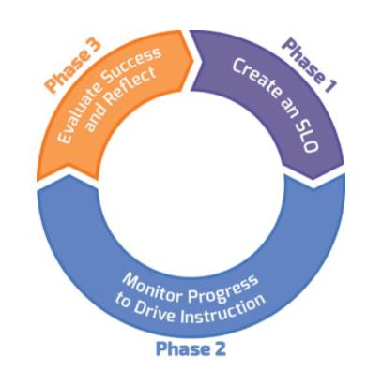
Three Phases of SLO
Notes:
1 min.
Trainer talk:
There are 3 phases in the SLO process.
Phase 1 happens before school starts up through the first few weeks of school and includes designing and writing the SLO.
Phase 2 is the longest in terms of time and includes the things teachers already do: teaching, assessing, documenting and adjusting. The mid-year conference also occurs during Phase 2.
Phase 3 is the end of the SLO when we review progress and reflect on the process.

Slide 29
Structure of the training - 2
Model/Activity/Your Turn
Key ideas
Success Criteria
Exemplars/Non-exemplars
Practice creating your own
Core Ideas
Key Takeaways
Flexibility and Questions
Notes:
2 min
Share the structure that we will use over the course of this training. Name that active participation is key. They will be learning, seeing exemplars, editing non-exemplars to make them better, and writing their own documents from scratch.

Slide 30
What we will cover…
Writing Quality SLO Skill Statements
Writing Quality Initial Skill Profiles (ISP)
Matching Students to the ISP
Writing Quality Targeted Skill Profiles(TSP)
SLO Form/Beginning of Year Conference
Collecting a Valid Body of Evidence (BOE)
Student Growth Tracker
SLO Mid-Year Conferences
Determining End of Year Skill Levels Based on BOE
EOY Conferences
30
Notes:
1 min.
Trainer talk:
These specific steps of the process will be covered in the full training.
Phase 1 includes steps 1-5
Writing Quality SLO Skill Statements
Writing Quality Initial Skill Profiles (ISP)
Matching Students to the ISP
Writing Quality Targeted Skill Profiles(TSP)
Revised SLO Form/Beginning of Year Conference
Phase 2 includes:
Collecting a Valid Body of Evidence (BOE)
Student Growth Tracker
SLO Mid-Year Conferences
And Phase 3 includes:
Determining End of Year Skill Levels Based on BOE
EOY Conferences
During day 1 we will cover the highlighted steps: steps 1-3 which part of Phase 1. On Day 2 we will cover the remaining steps in the process, finishing Phase 1, and covering all of Phase 2 & 3.

Slide 31
SLO Skill Statements
Notes:
1 min.
Trainer talk:
We will begin with learning what an SLO Skill Statement is and how to write one.

Slide 32
What is the focus of my SLO?
Notes:
1 min.
Trainer talk:
This is the first key question. Before we can develop a skill statement we must identify the area of focus. Essentially, we must identify the most important content of the course that would warranty being the focus of our SLO. Take a moment to consider this first step: What is the most important content of the course that warrants being the focus of my SLO? (pause)

Slide 33
SLO Skill Statement
The skill statement is a
description of what students should be able to do
with respect to the
foundational skill
by the end of the course/year.
33
Notes:
1 min.
Trainer talk:
The first thing we do in the SLO process is to determine our focus for the SLO and write a Skill Statement. The Skill Statement is a description of what students should be able to do with the foundational skill by the end of the course/year. This should be based on the TEKS or standards of the course and represents a skill that truly is foundational to the course.

Slide 34
Creating Skill Statements
Essential Question:
What are the most important skills I teach?
Notes:
2 min.
Spend some time on the concept of a foundational skill and how the TEKS can help determine/guide the decision. Think of it as the most important part of a particular course.
Provide examples such :
3rd grade math: although a lot is covered in 3rd grade math, one of the most (if not THE most) important part of 3rd grade math is learning multiplication and being able to use it to solve problems.
Spanish I: While there is some basic writing and grammar included in the course, the most important part of Spanish I is learning to understand basic spoken Spanish on common familiar topic (like greetings, food, family, weather, etc.) and be able to respond verbally (conversationally) in Spanish about those same topics.

Slide 35
Creating Skill Statements – 2
The Skill Statement emphasizes priority of content.
Aligned to standards for the course
Reinforces foundational skills
TEKS are used as a guide, but won’t cover all of them.
Teacher is able to provide clear explanation of the importance of the selected content for the SLO.
Notes:
2 min.
Trainer talk:
When considering the development of your Skill Statement, keep these clarifications and details in mind.
Talk through each point on the slide to reinforce the understanding of a foundational skill.

Slide 36
Success Criteria for Writing
an Effective Skill Statement
Represents a foundational skill that is specific to the content area
Persists throughout the course
Measurable through a demonstration of student skill
Focus on it will lead to student and teacher growth in this course and beyond
The skills captured are clearly defined and appropriately focused
36
Notes:
2 min.
Trainer talk:
Each step of the SLO process has Success Criteria. This is the set of Success Criteria for the first step, writing a Skill Statement.

Slide 37
SLO Skill Statements – 2
Non-Example
Example
Students will analyze the Civil War.
Students will analyze multiple pieces of evidence, including primary documents, to make claims and justify conclusions.
Notes:
2 min.
Trainer talk:
In the non-example, the statement is specific to one topic (the Civil War) and not specifically about the skill.
In the example, the skill of using primary sources, among other historical documents, to make claims and justify conclusions is named as a skill that can be applied across a variety of time periods/historical events.

Slide 38
SLO Skill Statements – 3
Success Criteria
Example
Represents a foundational skill that is specific to the content area
Persists throughout the course
Measurable through a demonstration of student skill
Focus on it will lead to student growth in this course and beyond
The skills captured are clearly defined and appropriately focused
Students will analyze multiple pieces of evidence, including primary documents, to make claims and justify conclusions.
Notes:
Two min.
Trainer talk:
How does the example Skill Statement on the right represent the Success Criteria on the left?
Allow participants to respond in chat if virtual or verbally in person.

Slide 39
SLO Skill Statements – 4
Non-Example
Example
Students use drawing techniques to complete projects.
Use conventions of shading (light and dark) to convey perspective in a pencil/pen sketch.
Notes:
2 min.
Give participants time to read the slide and decide the main differences between the non-example and the example independently. (1 min)
Then review the main differences. (1 min)
In the non-example the statement is very vague and does not specify which “drawing techniques” will be used.
In the example, the specific skill of shading to convey perspective in a drawing is clearly named.

Slide 40
SLO Skill Statements – 5
Success Criteria
Example
Represents a foundational skill that is specific to the content area
Persists throughout the course
Measurable through a demonstration of student skill
Focus on it will lead to student growth in this course and beyond
The skills captured are clearly defined and appropriately focused
Use conventions of shading (light and dark) to convey perspective in a pencil/pen sketch.
Notes:
2 min.
Trainer talk:
How does the example Skill Statement on the right represent the Success Criteria shown on the left?
Allow participants to respond in chat if virtual or verbally in person.

Slide 41
SLO Skill Statement Exemplars
Individually (silent/solo) read your assigned Exemplar Skill Statements from each of the three groups of statements on p. 3 of the Teacher Orientation Manual (5 min.)
Be prepared to discuss in groups:
What do you notice?
How does each exemplar align to the Success Criteria?
Notes:
5 min. silent solo
9 min. small group
5 min. share out
Give participants 5 minutes on their own (silent/solo) to read their assigned Exemplar Skill Statements noted on p. 3 of the Teacher Orientation Manual and identify how they align to the Success Criteria.
(9 min.)
Place participants in breakout rooms (virtual) or small groups (in person) to discuss.
Groups/Rooms 1-4 take the first statement in each group
Groups/Rooms 5-8 take the second statement in each group
Groups/Rooms 9-12 take the third statement in each group.
(5 min.)
In whole group, call on two or three groups to share their discussion.
Follow up with open discussion. All are exemplars, but some participants may feel that one or more of these Exemplar Statements is not strong enough. Give them the opportunity to adjust statements in order to strengthen, as long as aligns to Success Criteria. Remind participants that these are positive examples but are not perfect and may well be improved, especially by a teacher who is an expert in the content area.

Slide 42
SLO Skill Statement Non-Exemplars
Individually (silent/solo) read your assigned Non-Exemplar Skill Statements from each of the three groups of statements on p. 4 of the Teacher Orientation Manual. (5 min.)
Be prepared to discuss in small groups (5 min.)
What do you notice?
Where are the gaps in order to align to the Success Criteria?
What advice would you give your colleague in order to strengthen these Skill Statements?
Notes:
5 min. silent solo
5 min. small group
5 min. share in whole group/Collaboration board
Give participants 5 minutes on their own (silent/solo) to read their assigned Non-Exemplar Skill Statements on p. 4 of the Teacher Orientation Manual and identify the gaps in how they align to the Success Criteria, as well as probing questions they would ask the teacher. Then place participants in groups/breakout rooms to discuss.
Example of group assignments:
Groups/Rooms 1-4 take the first statement in each non-exemplar group.
Groups/Rooms 5-8 take the second statement in each group.
Groups/Rooms 9-12 take the third statement in each group. (5 min.)
Upon return to whole group, ask one group from each section to share the gaps they found and the questions they would ask the teacher. A collaboration board in Nearpod works great for this.
Then cover the sample gaps listed below.
Example gaps for each statement:
3rd grade math - Lacks clarity; question as to whether it’s a foundational skill; question as to whether or not it’s measurable
French I – issues with measurability (i.e., how do you reconcile the speaking and writing, and how does the writing play into presenting) Are questions about French culture foundational for French I?
Culinary Arts 101 – foundational skill (i.e., is this enough of a skill progression for a whole course?); not specific enough; what are proper cooking conditions?
Communications – clarity (how do written and verbal communications play into the design of the plan?); measurable (problem solving and communications are both big – how do you reconcile those two in measurement?)
11th grade U.S. History – measurement (how do you measure the use of primary sources in oral explanations?); clarity (what is meant by the “purpose of historical events”?)
6) 8th grade science – clarity (is this too broad, i.e., what’s the context for these skills that is particular to 8th grade science?); measurable (what’s the measure of this skill look like?)
7) Advanced Jazz Ensemble – foundational skills (are both of those – improv and historical context – both foundational?); measurable (how do you reconcile those two pieces, and do those two piece go together, or are those very separate things?) Mixes two very different things: improvisation and history of jazz.
8) 9th grade ELA –Not clear how this will be measured; (how will you measure or ask students to demonstrate the skill while using a variety of sources – science, social studies, etc.); Vague in content—is this about informational texts? Making an argument?
9) 5th Grade Music-Vague language. What are the “music events” and how exactly will students demonstrate skill levels?

Slide 43
Strengthening Non-Exemplar
Skill Statements
Using Success Criteria as a guide:
Determine where the gap is
Add in what is missing
Use the TEKS to ensure Skill Statement reflects foundational skill
Notes:
1 min.
Trainer talk:
These are the steps to take to convert a Non-Exemplar statement into an Exemplar Statement. We will model this process first, and then you will have a chance to do this on your own.

Slide 44
TEKS Connection
§130.254. Culinary Arts (Two Credits), Adopted 2015.
(a) General requirements. This course is recommended for students in Grades 10-12. Recommended prerequisites: Principles of Hospitality and Tourism and Introduction to Culinary Arts. Students shall be awarded two credits for successful completion.
8) The student evaluates and determines equipment, ingredients, and procedures used in a professional food setting. The student is expected to:
(A) identify and demonstrate the role of mise en place in professional food service
(B) identify and use large and small equipment in a commercial kitchen;
(C) develop and practice food production and presentation techniques;
(D) identify and use the appropriate application of moist, dry, and combination cookery methods;
(E) demonstrate the preparation skills of items commonly prepared in food service operations such as breakfast cookery, salads and dressings, soups and sandwiches, stocks and sauces, appetizers, seafood, poultry, meat, pastas and grains, and fruits and vegetables;
(F) demonstrate baking techniques such as yeast breads and rolls, quick breads, and desserts.
44
Notes:
1 min.
Trainer talk:
On this slide we see a portion of the TEKS for Culinary Arts I. The highlighted parts represent the part of the course that the teacher believes is the most “foundational”, which is learning to cook food properly and safely.

Slide 45
TEKS Connection – 2
§130.254. Culinary Arts (Two Credits), Adopted 2015.
(a) General requirements. This course is recommended for students in Grades 10-12. Recommended prerequisites: Principles of Hospitality and Tourism and Introduction to Culinary Arts. Students shall be awarded two credits for successful completion.
(12) The student explains how employees, guests, and property are protected to minimize losses or liabilities. The student is expected to:
(A) determine the basics of safety in culinary arts;
(B) assess workplace conditions and identify safety hazards;
(C) determine the basics of sanitation in a professional kitchen;
(D) determine proper receiving, storage, and distribution techniques;
(E) demonstrate proper cleaning of equipment and maintenance in the commercial kitchen;
(F) assess food hazards and determine ways to prevent food hazards; and
(G) prepare for a state or national food sanitation certification or other appropriate certifications.
45
Notes:
1 min.
Trainer talk:
In addition, this part of the TEKS for Culinary arts further defines safety and aligns to state and national standards for food sanitation. Although there are many more parts to the course, and many more TEKS, these two excerpts from the TEKS, together form the foundation of the course, so these are what will guide this teacher’s SLO Skill Statement.

Slide 46
Consult the TEKS as a general guide
SLO Skill Statements are:
Still about a foundational skill of the course
The most important “bits” of the course
SLOs are not about all of the TEKS, rather about the most enduring aspects.
46
Notes:
1 min.
Trainer talk:
Using the TEKS is a great place to start, but remember that they are a guide, and SLOs are not about every single TEK for the course. Rather, SLOs highlight the most foundational parts of the course.

Slide 47
Core Idea – 3
To produce the greatest depth of learning, the most effective teachers prioritize their time around the foundational knowledge and skills; they don’t chase TEKS.
Notes:
2 min.
Trainer talk:
This brings us to a Core Idea.
Read the slide and allow participants to process.
Trainer talk:
Our most effective teachers have a keen sense for what skills matter most and recognize that the deeper they can take their students with those skills, the more significant their students’ learning will be overall.

Slide 48
Strengthening Skill Statements
Before
After
Culinary Arts 101- Students will use proper cooking conditions and follow recipes to prepare nutritionally sound meals.
Students will be able to plan and prepare a nutritionally sound meal, applying industry standard cooking techniques and using American Culinary Federation Education Standards for sanitation and safety.
Notes:
2 min.
Ask participants to read the “before” and “after” skill statements.
Ask participants:
What do you notice?
How does the “After” version align better to the Success Criteria for Skill Statements?
Have participants share how the “after” version aligns to the Success Criteria.
(Collaborate Board in Nearpod or Jamboard for virtual, or at their tables in person)
Main differences:
The “After” version is more specific, aligns to the TEKS, refers to industry standards for both cooking techniques and sanitation.

Slide 49
Strengthening Skill Statements – 2
Before:
After
3rd Grade Math -Students will summarize data with multiple categories using a frequency table, dot plot, pictograph, and bar graph with scale intervals. They will also solve one and two step problems using categorical data represented with a frequency table, dot plot, pictograph, or bar graph with scaled intervals.
Students will be able to recall basic multiplication and division facts with fluency and accuracy and apply their understanding of multiplication and division to solve one and two-step word problems.
Notes:
3 min.
Have participants compare the “Before” and “After” statements.
What do you notice?
How does the “After” version align better to the Success Criteria for Skill Statements?
Have participants share how the “After” version aligns to the Success Criteria.
(Collaborate Board in Nearpod or Jamboard for virtual, or at their tables in person)
Main points:
“After” statement is clearer, and describes an overarching skill, whereas the ”Before” statement reads more like a list of tasks to do than a skill statement.
“After” statement is aligned to TEKS, names a specific skill (multiplication and division) as well as how students will be expected to apply that skill.

Slide 50
Activity – 2
In groups:
Select one of the three non-exemplar skill statements you reviewed previously.
As a group, strengthen it to align with the Success Criteria.
Prepare to share your before/after versions and rationale in whole group.
50
Notes:
9 min. total
5 min. small groups
4 min. to post and discuss
Share directions with participants (below and on slide) and provide clarification as needed.
5 min.
In groups:
Select one of the three non-exemplar skill statements you reviewed previously
As a group, strengthen it by filling in identified gaps to align with the Success Criteria
Be prepared to share your before/after versions of the skill statement when we come back and talk us through your revised Skill Statement.
(Trainer, clarify how they will share based on virtual or in-person training.)
4 min.
Have a writing activity ready in Nearpod, Jamboard or on chart paper (in person) so they can post their answers. Select 2 or 3 groups to share how they revised their non-exemplar Skill Statement.
After groups share, the trainer will provide the full list of revised Skill Statements (Before and After) as a resource. Trainers will find this on at Texasslo.org.
https://texasslo.org/Resource_files/trainers/Revised_SLO_Skill_Statements.pdf

Slide 51
A Resource to Review (and use later!)
You can find the full list of revised Skill Statements in the Google drive, and also in the chat. Take a few minutes to review.
What do you notice about the revised skill statements compared to their original non-exemplar format?
51
Notes:
3 min.
Point participants’ attention to the “Revised Skill Statements” document shared on the previous slide. This is a resource for later. The point here is to point out the resource, make sure they have access to it, and allow them to become familiar with the document overall. They won’t have time to read the whole thing right now. Remind them that this is a resource for later.
Give participants 3 minutes to review the list of revised SLO Skill Statements. Address any questions or comments in the chat.

Slide 52
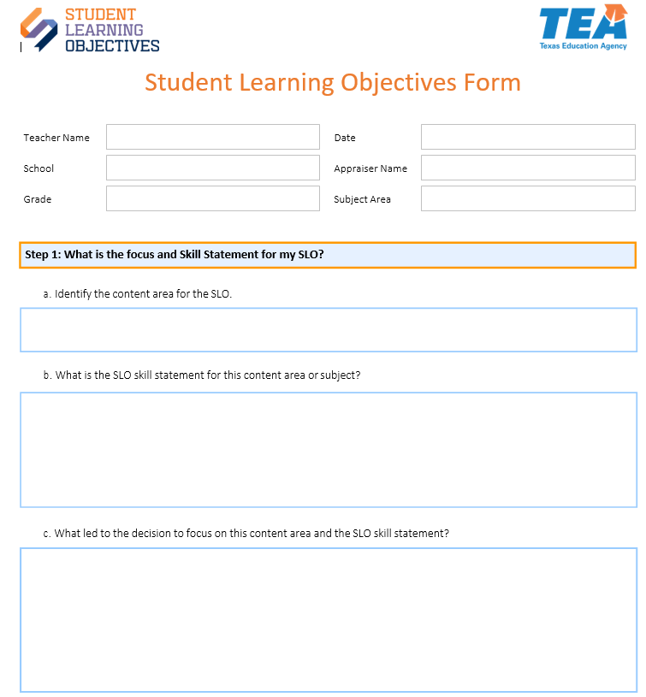
Student Learning Objectives Form
Use a blank SLO Form to record your Skill Statement.
Notes:
2 min.
Allow two minutes for participants to locate the SLO Form document (electronic preferred or hard copy) and prepare for the next task.
Trainer must plan how documents will be shared prior to training. This may include preparing Google doc folders for participants ahead of time, so they will have a place to document their work, and the presenter can see their work as they write, if possible, or for participants to have access to an electronic copy of the form and store in their own folder.
Please see the Trainer section at Texasslo.org for documents to support your plan to share documents.
SLO Form - https://texasslo.org/Resource_files/resources/SLO_Form.pdf

Slide 53
Your Turn!
Using either the last subject you taught, or your favorite subject, write an SLO Skill Statement that aligns to the Success Criteria.
(7 minutes)
Hint: look up the TEKS for your course to get started!
TEKS main site
Be prepared to share.
The Skill Statement you create will be the basis of your work for the rest of this training.
53
Notes:
10 min. total
7 min.
Participants will use the blank SLO Form provided (digital form preferred).
Provide link to the TEKS website in the Chat for virtual training or via anchor chart or email for in person training - https://tea.texas.gov/academics/curriculum-standards/teks/texas-essential-knowledge-and-skills
Direct participants attention to the SLO Form in the Google Drive. Ideally, they will write their own SLO Skill Statement on the SLO Form in their Google folder. or on the form they download into their own folder. If time permits, they can answer the remaining questions on Step one of the form.
For virtual training, share some exemplars in progress in this manner:
As participants write in their electronic forms, if you created folders, open a few to find exemplars. Send a private message request in Zoom to ask them if they would be willing to share their work with the group.
Selected participants share the SLO Skill Statement they wrote.
3 min.
Presenter shares screen that shows the SLO Skill Statement from the Google folder of the selected participant who will share, and the participant walks the group through what they wrote and why, in particular highlighting how their Statement aligns to the Success Criteria.

Slide 54
Logistics - Year One
When do I determine the content area and focus for my SLO?
At the beginning of the year after SLO teacher orientation
When do I write my SLO Skill Statement?
During the first few weeks of school
Notes:
2 min.
Trainer talk:
Naturally, teachers and their appraisers won’t be able to make this determination until teachers have been trained on the SLO process but these are important questions and considerations as SLOs are implemented.

Slide 55
Logistics - Years Two and Beyond
When do I determine the content area for my SLO?
During my End-of-Year Conference when mapping out my goal-setting and professional development plan
When do I determine the skill focus for my SLO?
Before school starts or immediately after school begins
When do I write my Skill Statement?
During the first few weeks of school
Notes:
2 min.
Trainer talk:
Typically, a teacher and administrator would look at determining the content area at the end of the school year during their end of year conference. You would choose the content area because it would be based on an area of need for student growth. Content area can be as broad as subject for a generalist and as specific as writing (within a range of content areas) for an ELA teacher.”
After choosing the content area, the teacher would determine their skill focus based on the most important skills the teacher teaches and how they can improve their effectiveness in teaching that skill
Next is writing the actual Skill Statement, which should happen within the first few weeks of school.
REMEMBER – SLOs are about student growth. The skill statement is the lens through which student growth will be determined. That lens is best when it stays fixed on the most important skills taught throughout the year.

Slide 56
Reflections – 2
What are your key takeaways from this section of the SLO?
Notes:
3 min.
Have participants spend two minutes in silent writing in their Teacher Orientation Manual to capture their key takeaways from the SLO Skill Statement section of the training. There is space for notes at the back of the Teacher Orientation Manual on p. 50.

Slide 57
Key Takeaways – 2
Skill statements should narrow the focus for the SLO.
Foundational skills vs TEKS chasing.
Success criteria provide guidance.
Finding potential gaps in SLO Skill Statements can be a coaching opportunity: ask questions.
Notes:
1 min.
Trainer talk:
Here are the key takeaways we landed on.

Slide 58
Initial Skill Profile Section
Notes:
Remind participants to have Participation Manual available to use.

Slide 59
Core Idea – 4
The most effective teachers teach the students they have, not the students they think they’ll have.
Notes:
1 min.
Trainer talk:
This brings us to our Core Idea.
Read the slide and let it sit for a second.
Trainer talk:
Our most effective teachers shape their plans and approach based on their constant analysis of their students’ needs.

Slide 60
Who are my students?
Notes:
1 min.
Trainer talk:
Now moving on to Question 2 from the Big Six Questions: Who are my students?

Slide 61
Who are my students?
There are two different parts in this section:
What do I expect my students will be able to do with this skill statement, based on what is typical in my experience?
What are my students actually able to do, based on multiple data points?
Notes:
2 min.
Trainer talk:
There are two parts needed to answer the question, “Who are my students?”
Click a) What are the descriptors that cover the range of entering skill levels with respect to the Skill Statement, that students typically have at the beginning of the year, and
Click b) Based on evidence, where do my current students fall within this range of skill descriptors?
We will cover part a first. (Click animated arrow to emphasize.)
First, you need to think about the entering skill levels of who you expect or assume will be in your classroom. You want the assumptions exposed because all teachers have assumptions. The place to start is the teachers’ experience of the skill levels that students typically have at the beginning of the year as it relates to the Skill Statement. What specific descriptors truly describe a “typical entering skill level”? This part needs to be grounded in a specific description of what students know and are able to do across a variety of entering skill levels.
For example, consider a kindergarten teacher whose experience is such that a typical entering skill level is students know the alphabet letters and the initial sound each letter makes, but don’t yet understand how to combine letters to create phonemes and begin to read. In this case, that description might qualify as a “typical skill level” for the beginning of the year. A below typical skill level might be that students know some, but not all, letters of the alphabet, and sometimes confuse the initial sound that the letters make. An above typical skill level in this teacher’s experience might be that students know all letters and the initial sounds they make, as well as some common phonemes that they can apply to emergent reading.
The idea is to capture the list of specific skills that students have at the beginning of the year, across a variety of entering skill levels.

Slide 62
Creating an Initial Skill Profile
An Initial Skill Profile (ISP):
Is a skill progression rubric
Describes different levels of student proficiency with respect to the foundational skill.
Begins with what a student “typically” knows and can do when they walk in the door at the beginning of the year (with respect to the skill selected for the SLO).
Notes:
1 min.
Emphasize that this is a skill profile, so it is about describing skill levels across a variety of different levels. Be sure to ground this work on the skill levels of students by using specific descriptors. Use words such as:
A typical beginning of year skill level looks like…
rather than
A typical student looks like this…

Slide 63
Success Criteria for Writing an Effective Initial Skill Profile
Articulates skills for the beginning of the year
Differentiates between levels
Descriptors align to skill statement
Can be assessed in multiple ways
Based on multiple sources of evidence/a teacher’s experience
63
Notes:
2 min.
As with the Skill Statement, there are Success Criteria for Initial Skill Profiles. You can find these at the top of page 5 in the Teacher Orientation Manual.

Slide 64
Initial Skill Profile: Exemplar
Skill Statement 8th ELA: Students will be able to draw accurate conclusions supported by appropriate textual evidence from informational texts
Level | Descriptors
Well above typical skill | Students can summarize the most significant information with informational texts, consistently make accurate inferences, and can often connect inferences with appropriate textual evidence, although written explanation of evidence is often weak or underdeveloped.
Above typical skill | Students can summarize the most significant information with informational texts and often make accurate inferences, although they struggle to connect inferences with appropriate textual evidence.
Typical skill | Students can comprehend informational texts with consistent success summarizing the most significant information, although students often fail to make accurate inferences.
Notes:
2 min.
This can be found in Teacher Orientation Manual page 6.

Slide 65
Initial Skill Profile: Exemplar – 2
Skill Statement 8th ELA: Students will be able to draw accurate conclusions supported by appropriate textual evidence from informational texts
Level | Descriptors
Typical skill | Students can comprehend informational texts with consistent success summarizing the most significant information, although students often fail to make accurate inferences.
Below typical skill | Students can comprehend informational texts but struggle to summarize the most significant information.
Well below typical skill | Students struggle to comprehend informational texts and are generally unable to summarize the most significant information.
Notes:
2 min. total
1 min.
Allow participants to read the three different levels on this slide and pull out what is different between each level.
1 min.
Have volunteers write in chat or come off mute to share specific skill differences between the 2 levels.

Slide 66
Initial Skill Profile
Skill Statement 8th ELA: Students will be able to draw accurate conclusions supported by appropriate textual evidence from informational texts
Success Criteria of an ISP
Articulates skills for the beginning of the year
Differentiates between levels
Descriptors align to skill statement (potentially through subskills)
Can be assessed in multiple ways
Based on multiple sources of evidence/a teacher’s experience
Partial ISP | Skill Descriptors
Above typical Skill | Students can summarize the most significant information with informational texts and often make accurate inferences, although they struggle to connect inferences with appropriate textual evidence.
Typical Skill | Students can comprehend informational texts with consistent success summarizing the most significant information, although students often fail to make accurate inferences.
66
Notes:
3 min.
Ask participants to which success criteria on the left do the skill descriptors from the ISP on the right align.

Slide 67
Initial Skill Profile – 2
Skill Statement 8th ELA: Students will be able to draw accurate conclusions supported by appropriate textual evidence from informational texts
Success Criteria of an ISP
Articulates skills for the beginning of the year
Differentiates between levels
Descriptors align to skill statement (potentially through subskills)
Can be assessed in multiple ways
Based on multiple sources of evidence/a teacher’s experience
Partial ISP | Skill Descriptors
Above typical Skill | Students can summarize the most significant information with informational texts and often make accurate inferences, although they struggle to connect inferences with appropriate textual evidence.
Typical Skill | Students can comprehend informational texts with consistent success summarizing the most significant information, although students often fail to make accurate inferences.
67
Notes:
1 min.

Slide 68
Initial Skill Profile Exemplar – 3
Skill Statement Culinary Arts I: Students will be able to plan and prepare food commonly served in food service operations,(aligned to USDA standards) applying industry standard cooking techniques and using American Culinary Federation Education Standards for sanitation and safety.
Level | Descriptors
Well above typical skill | Students have considerable experience with cooking and report often helping to cook the family meals, including cooking some dishes independently. Students are familiar with cooking techniques and safety standards.
Above typical skill | Students have cooked one or two dishes independently and sometime assist in cooking family meals. Students are aware of some cooking techniques and safety standards
Typical skill | Students have some cooking experience, typically assisting family members as they prepare meals, but have not cooked independently. Students with prompting can recognize basic cooking techniques and safety standards.
Notes:
2 min.
This is another exemplar ISP. On this slide we show Typical Skill, Above Typical Skill and Well Above Typical skill. The rest of the levels are on the next slide.
Have participants take a minute to read each of the 3 skill levels on this slide and consider how they align to the Skill Statement at the top.

Slide 69
Initial Skill Profile – 3
Skill Statement Culinary Arts I: Students will be able to plan and prepare food commonly served in food service operations,(aligned to USDA standards) applying industry standard cooking techniques and using American Culinary Federation Education Standards for sanitation and safety.
Level | Descriptors
Typical skill | Students have some cooking experience, typically assisting family members as they prepare meals, but have not cooked independently. Students with prompting can recognize basic cooking techniques and safety standards.
Below Typical skill | Students have a little cooking experience, typically with prepared foods/cake mixes/refrigerated cookie dough, etc. Students are not aware of most basic cooking techniques but recognize some basic safety standards.
Well Below Typical skill | Students have no cooking experience and are not aware of basic cooking techniques or safety standards.
Notes:
2 min.
Here is the rest of this ISP. This slide shows again the Typical skill level for reference, as well as the Below and Well Below Typical skill levels.
Again, have participants read the 3 skill levels shown and look for how this ISP aligns to the Success Criteria for ISP. (List of ISP Success Criteria is on p. 8 of Teacher Orientation Manual.)

Slide 70
Initial Skill Profile – 4
Skill Statement Culinary Arts I: Students will be able to plan and prepare food commonly served in food service operations,(aligned to USDA standards) applying industry standard cooking techniques and using American Culinary Federation Education Standards for sanitation and safety
Success Criteria of an ISP
Articulates skills for the beginning of the year
Differentiates between levels
Descriptors align to skill statement
Can be assessed in multiple ways
Based on multiple sources of evidence/a teacher’s experience
Partial ISP
Typical Skill | Students have some cooking experience, typically assisting family members as they prepare meals, but have not cooked independently. Students with prompting can recognize basic cooking techniques and some safety standards
Below Typical Skill | Students have a little cooking experience, typically with prepared foods/cake mixes/refrigerated cookie dough, etc. Students are not aware of most basic cooking techniques or safety standards.
70
Notes:
3 min.
Ask participants to indicate which of the success criteria on the left are represented in the part of the ISP included on the right. Remind them to re-read the Skill Statement at the top, and focus on how the two levels are different from each other with respect to student skills described. Then ask them to draw check marks on the Nearpod Draw It to indicate their answers.

Slide 71
Initial Skill Profile – 5
Skill Statement Culinary Arts I: Students will be able to plan and prepare food commonly served in food service operations,(aligned to USDA standards) applying industry standard cooking techniques and using American Culinary Federation Education Standards for sanitation and safety
Success Criteria of an ISP
Articulates skills for the beginning of the year
Differentiates between levels
Descriptors align to skill statement (potentially through subskills)
Can be assessed in multiple ways
Based on multiple sources of evidence/a teacher’s experience
Partial ISP
Typical Skill | Students have some cooking experience, typically assisting family members as they prepare meals, but have not cooked independently. Students with prompting can recognize basic cooking techniques and some safety standards
Below Typical Skill | Students have a little cooking experience, typically with prepared foods/cake mixes/refrigerated cookie dough, etc. Students are not aware of most basic cooking techniques or safety standards.
71
Notes:
2 min.
Discuss answers and take any questions. Some participants might have gotten different answers, and that is ok. Probe for rationale.

Slide 72
Initial Skill Profile Non-Exemplars
Individually (silent/solo) read your assigned Non-Exemplar ISP.
Be prepared to discuss in groups:
What do you notice?
Where are the gaps in order to align to the Success Criteria?
What probing questions would you ask the teacher in order to strengthen these ISPs?
Notes:
2 min. Read silent/solo
5 min. Table groups/breakout rooms
4 min. Share out - What gaps did your group see? (2 min per each group)
4 min. Share out - What probing questions would you ask the teacher? (2 min per each group)
Give participants 2 minutes on their own (silent/solo) to read their assigned Non-Exemplar ISP on p. 7-8 of the Teacher Orientation Manual and identify the gaps in how they align to the Success Criteria, as well as probing questions they would ask the teacher. Then ask participants to discuss in table groups/ breakout rooms for five minutes.
Groups/Rooms 1-6 take the first non-exemplar, 7th Grade Science.
Groups/Rooms 7-12 take the second non-exemplar, Culinary Arts.
When back in whole group, ask one room from each assigned non-exemplar to share the gaps they found and the questions they would ask the teacher.
Example gaps for each ISP:
7th grade science – differentiation between levels (below typical and well below seems like a massive drop); alignment to skill statement (graphic displays not present – is that intentional?)
Culinary arts – alignment to skill statement (why are STAAR results pertinent?); differentiation (well above and above seem like a large leap; typical seems like it could be higher level than above typical).

Slide 73
Revising a Non-Exemplar ISP: 3rd Grade Math
Where are the gaps?
How can you align better to the skill statement?
How can you make it clearly measurable?
73
Notes:
1 min.
Explain that we are going to take a non-exemplar ISP and revise it to make it stronger. The purpose of this exercise is to have practice doing this ourselves, so that we can be able to coach teachers to do it. In practice, school leaders most likely will not be revising ISPs, but they will have to coach teachers to be able to revise ISPs, so this is some initial practice for teacher appraisers to have tried this and gained some experience/familiarity with the process in order to be able to coach it.

Slide 74
One Example: Revised 3rd Grade Math ISP
Skill Statement: Students will be able to recall basic multiplication and division facts with fluency and accuracy and apply their understanding of multiplication and division to solve one and two-step word problems.
Level | Descriptors
Well Above Typical Skill | Students can multiply independently but are not able to use multiplication skills to solve one or two step word problems.
Above Typical Skill | Students can add and subtract four-digit numbers with accuracy and multiply some numbers independently, without support
Typical skill | Students can add and subtract four-digit numbers with accuracy and multiply some numbers when given support like manipulatives.
Below Typical Skill | Students can add and subtract four-digit numbers with difficulty and often without accuracy. Students understand groupings of numbers but cannot multiply numbers.
Well Below Typical Skill | Students can add four-digit numbers but struggle with subtraction and regrouping.
74
Notes:
5 min. total
3 min.
Have participants compare this revised 3rd grade math ISP ( on the slide and also on p. 12) of the Teacher Orientation Manual to the original non-exemplar 3rd grade math ISP in their Teacher Orientation Manual on p.10. What has changed? Participants should jot notes to share what has changed from the non-exemplar version on p. 10 to the revised version shown on this slide.
2 min.
Allow a few participants share out what has changed in the revised version.

Slide 75
Changes from Non-Exemplar to Revised Version
Revised Version of ISP:
Descriptors for each level align to the skill statement.
Specific tasks are mentioned.
The skill level/tasks are measurable in multiple ways.
Each level specifies increasing level of measurable skill.
Progression from each level to the next makes sense.
75
Notes:
1 min.
Trainer talk:
As your comments suggested, here is the main list of changes from the non-exemplar version to the exemplar version.

Slide 76
A Resource to Review (and use later!) – 2
Review list of Revised ISPs
What do you notice about the revised ISPs compared to the original non-exemplar format?
76
Notes:
2 min.
Share the Revised ISPs From Non-Exemplars document (hard copy or electronic). The document is available at Texasslo.org under the Trainer tab when logged in. https://texasslo.org/Resource_files/trainers/Revised_ISPs_from_non-exemplars.pdf
Give participants 2 minutes to review the document that has all of the revised ISPs. Ask them to select one and compare it to the non-exemplar counterpart on pages 7-10 of the Teacher Orientation Manual.
What is different in the corrected version of the ISP, compared to the original non-exemplar version?
4 min.
Address each subject area one at a time.
Ask a participant volunteer to share what noticed between the before and after versions of each ISP.
7th Grade Science: (1 min.)
Culinary Arts: (1 min.)
French I: (1 min.)
3rd Grade Math: (1 min.)
Participants can review this resource later and compare the differences between the four revised ISPs in more detail.

Slide 77
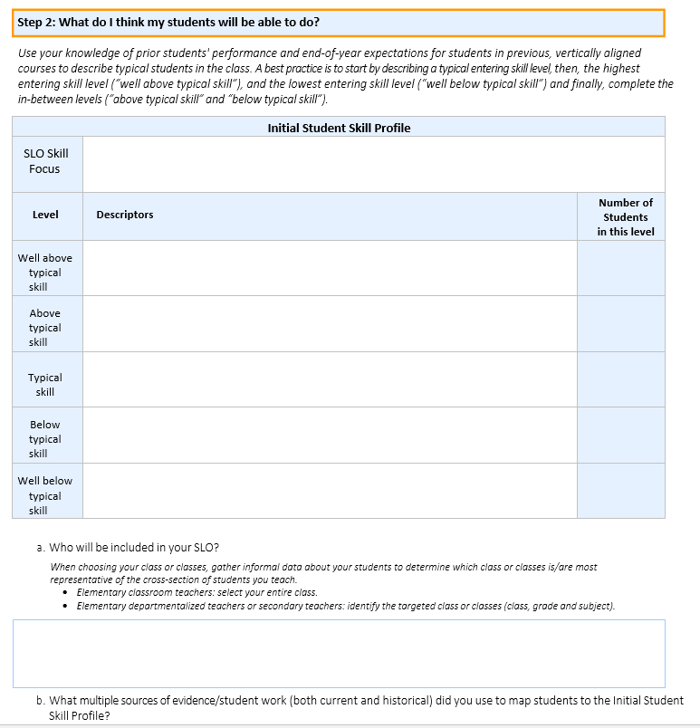
Step 2: What do I think my students will be able to do?
Notes:
1 min.
Direct participants to their individual SLO Form that they have begun. They will be asked to write their own Initial Skill Profile (ISP) for the Skill Statement that they wrote earlier in the training day.

Slide 78
Your Turn! – 2
On your own and using the SLO Skill statement you wrote this morning, create an Initial Skill Profile.
Record on the SLO Form.
You will have 15 minutes.
Hint: Use the TEKS! TEKS main site
Hint: Use the Success Criteria.
We will select a few to share, with permission.
You will use the ISP you create for during the next part of the training.
78
Notes:
15 min.
Share the TEKS main site link: https://tea.texas.gov/academics/curriculum-standards/teks/texas-essential-knowledge-and-skills
Share the directions.
Framing: For school leaders who have not been in the classroom for a while, this might feel like a task that they are not prepared to do. The goal in asking them to do this is so that they can be the most effective coaches for their teachers as possible. Taking a stab at writing an ISP themselves, is one of the best ways for them to prepare to coach teachers in this work. Name that school leaders won’t be required to write their own ISPs, teachers will do this. However, it is the responsibility of the school leaders to coach teachers as well as approve their teachers ISPs. Because of this responsibility, it is critical that school leaders have this background in order to be prepared to approve teachers’ work in this area.
Participants have 15 minutes to write. Note that if they don’t get all 5 levels done in 15 min. it’s okay. The point is to get the feel of writing a quality ISP, so they will be able to coach teachers to do it. These don’t have to be perfect!
As participants write, the trainer reviews participants’ work if possible (Google folders or live). Select 2-3 participants whose ISPs look promising and privately (via Zoom or in person) ask if they would be willing to share when we return to full group. If they agree, presenter shares (via Zoom screen or document camera) and the participant walks group through their work.
Allow 5 minutes for sharing participant work.

Slide 79
Success Criteria for Writing an Effective Initial Skill Profile – 2
Articulates skills for the beginning of the year
Differentiates between levels
Descriptors align to skill statement
Can be assessed in multiple ways
Based on multiple sources of evidence/a teacher’s experience
79
Notes:
2 min.
Trainer talk:
Reflect on the ISP you wrote. How does it align with the Success Criteria? Note which aspects of the Success Criteria the ISP you wrote demonstrates. You will be asked how you think you did in just a minute in a quick poll. (No one will see how you graded yourself, just the results from the overall group of participants as a whole will be shown.)

Slide 80
Reflections – 3
What are your key takeaways from this section on writing a quality Initial Skill Profile?
Notes:
3 min. total
2 min.
Have participants capture key takeaways from the ISP section of the training on notes page 50 in the Teacher Orientation Manual.
1 min.
Invite participants to share takeaways verbally.

Slide 81
Matching Students to the ISP
How do you determine which students fall into which entering skill levels?

Slide 82
Who are my students? – 2
There are two different parts in this section:
What do I expect my students will be able to do with this skill statement, based on what is typical in my experience?
What are my students actually able to do, based on multiple data points?
Notes:
3 min.
Trainer talk:
Now we will cover the second step in answering the question, “Who are my students?” This is documenting, based on multiple sources of evidence, where each student’s skill level actually falls within the ISP.
“One of the most notable flaws in ineffective instruction is teaching to the students teacher thought they would have, wished they had, or who they used to have long ago, not the ones they actually have sitting in front of them. Sometimes you see this when the same lesson plans are used year after year with little reflection on what needs to be adjusted based on student need.
This is one of the more valuable steps in the SLO process – recognizing, based on multiple data sources, the skill levels of the students actually sitting in front of the teacher in a given year.
This ensures that when teachers are planning, they are planning for the kids in their class this year, and the skill levels the students actually have.

Slide 83
Who are my students? – 3
We collect data about our current students’ skill level in order to assess current level of learning and map to the Initial Skill Profile.
Notes:
5 min. total
1 min.
Trainer talk:
This begins the second part of Step 2. Now the teacher has created their ISP that describes the skill levels that typically represent the spread of student entering skills. It is now time to collect data in order to actually map the students to their corresponding ISP level based on the students’ actual skills. The ISP itself can be written prior to students’ arrival. Once that is fleshed out and the students arrive, it can take 6 weeks to really get to know students’ actual entering skill levels based on multiple data points. This is where the teacher can use various types of data to determine the individual student skill levels as they relate to the SLO skill statement.
This will likely be a mix of formal and informal data. The goal here is that teachers are already getting to know their students through many methods. SLOs are designed to complement that process not create extra assessments. Administrators should encourage the staff to see what they are already using to gather information on their students’ skill levels. Examples include teacher created pre-tests, classwork during the first few weeks of school, homework, class participation, exit tickets, student work on any assignment/project/presentation that students complete during the first few weeks, etc.
Caution: district or campus based standardized assessments may or may not be a valuable source of data. For example, the district assessment may contain 30 questions, but only 3 questions might really pertain to a specific teacher’s Skill Statement. Those 3 questions could be helpful data, but using the whole test would not be accurate if the majority of questions don’t all align to the teacher’s focus.
2 min.
Think about 3-4 different types of data you might use for the ISPs you created, or for one of the ISPs we reviewed. What potential data sources do you think would be a good fit? You can record these in your notes or on your SLO form on Step 2, part b.
THE KEY IS TO USE MULTIPLE DATA SOURCES.
2 min.
Share some of the possible data sources below and/or ask participants to share data sources they might use.
Suggestions might include:
Grade 7 math:
Early quizzes (only using the questions focused on the SLO or sub skills)
Having students explain the process or concept tied to the SLO
Exit tickets
Any diagnostic tests given by the school/district
Grade 6 STAAR results for CURRENT students ONLY IF results can be mapped specifically to the skill in question.
Grade 5 Art:
Early student assignments/projects – perhaps giving a task that is directly tied to the issue of interest – here it is perspective
Classwork “quick sketch”
Art journal entries
A vocabulary quiz using the words that the teacher has focused on in the SLO
Knowledge from previous experience with these students
HS Culinary Arts:
Survey of students’ experiences with cooking
Early student work on a simple cooking task – perhaps assessed using a rubric similar to what would be used to judge the end product
Quiz on basic cooking techniques to see which techniques students know or don’t know
Food sanitation and safety checklist
Observation of students’ ability to follow basic cooking directions/read recipes

Slide 84
Who are my students? – 4
Timeline for writing ISP and collecting skill level data
*Depending on date of teacher SLO orientation
Year 1 | Year 2 and Beyond
First 6 - 9 weeks* | First 4-6 weeks
Notes:
1 min.
Trainer talk:
These are suggested timelines. In the first year, we say about 6-9 weeks. It is a new process and it might take a little longer to work through the first time around. In Year 2 and beyond, this process should be able occur faster. The recommended time frame shifts to the first 4-6 weeks of the school year. Again these are just recommendations and each district has the opportunity to set their own timelines. The timelines set here are designed to balance the time needed plan a thoughtful Skill Statement tweak the ISP as needed, and gather multiple sources of evidence in order to map each student to a corresponding skill level on the ISP.

Slide 85
Students’ Entering Skill Levels
Match Students to the ISP
Where are students in relation to the Skill Statement?
Use multiple sources of data to determine each student’s entering skill level.
Use current and historical data
To which skill level descriptor on the ISP does each student’s entering skill level most closely correspond?
Notes:
1 min.
These are the key points to consider when determining students’ entry skill level with respect to the Skill Statement.

Slide 86
Core Idea – 5
The most effective teachers teach the students they have, not the students they think they’ll have.
Notes:
1 min.
Trainer talk:
This brings us back to one of our Core Ideas.
Read the slide and let it sit for a second.
Trainer talk:
Determining to which skill level on the ISP each student’s beginning of year work most closely aligns, it is essential to use multiple data points.

Slide 87
Who are my students? – 5
8th Grade ELA Skill Statement:
Students will be able to draw accurate conclusions supported by appropriate textual evidence from informational texts.
The teacher gave five types of assessments to capture her students’ BOY skill levels
Each type was scored on five-point scale
Measures included (with grade-level informational texts):
Multiple choice passages (comprehend )
Response to a prompt (summarize)
Short answers (comprehend, textual evidence)
Analysis essay (inferencing, textual evidence)
Free Write (connect inferences to textual evidence)
Notes:
2 min.
Carefully name and review each of the 5 data points this teacher will use to determine her student’s initial skill levels.
Have participants pull out the 8th grade ISP exemplar on p. 6 of Teacher Orientation Manual, since this example of student skill levels is for an 8th grade ELA teacher. This is background for the next step in the process – mapping students to the ISP.
Trainer talk:
Let’s see how a teacher might approach this. Here is an example from an 8th grade English teacher. This teacher is using five types of assessments or measures that correspond to her SLO Skill Statement.
Each one is rated on a five-point scale – 5 is very accomplished and a 1= minimum skill or effort.
For this teacher, the data collected is directly related to the focus of the SLO. Her Skill Statement is focused on drawing accurate conclusions from informational texts and supporting those conclusions with optimal evidence.
Eachof these five assignments is designed to measure all or a part of the skills mentioned in the Skill Statement. Taken together, the teacher will be able to discern to which level of the ISP each students work most closely aligns.
IMPORTANT POINT - Teachers can and should use assessments they have already created or currently use where possible; the point is definitely not looking for the creation of assessments for SLOs.

Slide 88
What are my students’ BOY skill levels?
Student | Multiple Choice | Prompt Response | Short Answers | Analysis Essay | Free Write | Level
Maria | 5 | 4 | 4 | 4 | 4
Kendrick | 4 | 3 | 3 | 3 | 2
Felipe | 4 | 4 | 4 | 3 | 3
Dayana | 3 | 2 | 1 | 1 | 1
Violet | 3 | 3 | 2 | 2 | 1
88
Notes:
8 min.
Trainer talk:
As I share the evidence this teacher used, please follow along in the 8th Grade ISP Exemplar document on page 6 of Teacher Orientation Manual and jot down how you think the evidence for each student corresponds to the skill levels on the ISP.
Give them one minute after the presenter reads each student’s evidence to determine where they think each student falls and if they agree with the numbers on the slide.
It is VERY important to read student’s evidence clearly and slowly, so participants can get a sense of how the evidence aligns to the skill levels described in the ISP for this course. TIP, read each student’s evidence twice and pause between students. Otherwise participants won’t have time to actually process the information and map it back to the ISP.
Trainer talk:
At the beginning of the year a student who can score all 4s on the assignments, and even a 5 on one assignment this early in the year, is a student who has well above typical skill for the beginning of the year, like Maria. Similarly, a student who scores mostly 3s with a 2 on a more difficult assignment and a 4 on an easier assignment like multiple choice, is typical for an 8th grade student at the beginning of the year, like Kendrick. Be careful not to assume that numbers align exactly to specific skill levels on the ISP. The idea is to take all of the assignments together as a whole to determine the level on the ISP, using the specific descriptors for each level, that most closely aligns to each student's work. It's not about the numbers, per se. It's about the words that describe each skill level in the ISP and an analysis of student work to see to which level the student work most closely aligns. Numbers, letter grades, percent scores, etc. can be used to grade each assignment, but it is the group of assignments taken as a whole that paints the picture of where each individual student's skill level is at the beginning of the year and how that skill level compares to what is a typical skill level at the beginning of the year.
Maria did a great job on the multiple choice assignment. She was very independent and able to move through the assignment with very little support. So her MC level is a 5. She was accurate in her execution of the response to the prompt and short answer process. Her level for both of these this was a 4. Based on her reading, she was able to draw accurate and high-level conclusions for the analysis assignment and also was able to connect some of her inferences with evidence from the text. She was a strong 4 here on both of these as well.
Kendrick was able to work through the MC with some reassurance that he was correctly identifying the best answers. His independence level was 4 here because he did need some validation. He was accurate in summarizing on the prompt response, but his short answers were a little rigid and lacking in consistent clarity. His prompt response and short answer level were both strong 3s. For the most part, he was able to draw conclusions that were accurate in the analysis essay, but struggled to connect to the bigger, more complex concepts. With support and if the right questions were asked, he may have been able to make that leap. He was a 3 on analysis and a 2 on the free write.
Felipe was very independent in his MC work; his independence level here was a solid 4. He was able to summarize accurately in prompt response, which scored him at a 4, however during the short answer task, he sometimes would rush and wasn’t always accurate, which caused a few errors that he recognized and was able to work though. His SA level was a weak 4. As Felipe worked through his conclusions, he was able to make some solid conclusions and connections but he struggled to see clear patterns or lack thereof. His skill level in analysis and the free write were both at a mid-3 range.
Dayana was fairly independent with her multiple choice work and but needed a lot of support on the higher level questions. Her MC level was a 3. She did have a bit of trouble reading through the both the prompt and the short answer questions and at times would guess on how to respond. This caused her to be less accurate. She also had difficulty recognizing her errors and couldn’t catch them. Her prompt response was a 2 and her SA level was a 1. Because she was challenged by reading the material and interpreting the text, it caused her to really struggle with drawing conclusions. She couldn’t see the connections between the text and the larger concepts, so her conclusions were very difficult to understand. Her skill level with analysis was a 1. She was not able to make inferences or support them with evidence on the free write task, so she scored a 1 here as well.
Violet struggled to get through higher level questions of the MC assignment. She needed some support to understand what the assignment was asking. Her MC level is at a 3. Because she worked hard to understand what the text was saying, her summarization in the prompt response task was a 3. Once she was able to work through what the analysis task was asking her to think about, she was pretty accurate. She would at times miss the big picture, but overall she was mostly accurate in her work. Her SA level is at a 2. Violet used her text to draw mostly accurate conclusions. Some of her conclusions lacked depth, and she needed a lot of support from the teacher to even attempt to go deeper. Her analysis level is at a 2. She was able to make only basic inferences on the free write, and struggled to support them with evidence from the text. She was a strong 1 on the free write.

Slide 89
What are my students’ BOY skill levels? – 2
Student | Multiple Choice | Prompt Response | Short Answers | Analysis Essay | Free Write | Level
Maria | 5 | 4 | 4 | 4 | 4 | Well Above Typical Skill
Kendrick | 4 | 3 | 3 | 3 | 2 | Typical Skill
Felipe | 4 | 4 | 4 | 3 | 3 | Above Typical Skill
Dayana | 3 | 2 | 1 | 1 | 1 | Well Below Typical Skill
Violet | 3 | 3 | 2 | 2 | 1 | Below Typical Skill
89
Notes:
2 min.
Using the ISP for 8th Grade ELA, this is where each student’s work corresponds to the ISP skill levels.
Trainer talk:
You can see where each students’ skill level landed after the initial data were collected during the first few weeks of school. This teacher used multiple data points and possibly additional data such as historical data to map the students to the ISP. She used the evidence of student work to evaluate students’ ability to demonstrate and apply their skills. Are there any questions?

Slide 90
Who are my students? – 6
Use a preponderance of evidence when matching students to the ISP.
Just because they are placed in the same level doesn’t mean they have the same exact skill set.
Focus on accuracy versus precision.
90
Notes:
2 min.
Trainer talk:
When determining student skill level on the ISP, you want to use a preponderance of evidence as the standard. It may not be a clean placement of everything hitting in the exact area of the ISP levels but when you look at the multiple data points as a whole, you should be able to determine the best placement. You will find even within each level, a range of skills still exist. You may have high typical and lower typical but still they land in the typical range. That is to be expected. When looking at your evidence to support the student’s placement, we are looking to accurately capture their skill set but that doesn’t mean it is absolutely precise. Multiple examples of diverse types of assessments can give us an accurate picture.

Slide 91
Activity – 4
In your Teacher Orientation Manual use:
3rd grade math ISP - p. 11
3rd grade math ISP student work samples - pp. 13-22
Using the student work, map the students’ BOY skill levels to the ISP based on the skills their work demonstrates.
91
Notes:
10 min.
Silent/Solo
Participants will review actual student work and use it to map each student to their respective ISP level.
Direct participants to the 3rd Grade ISP Student Work document on pages 13-22 of their Teacher Orientation Manual or at this link: https://texasslo.org/Resource_files/trainers/ISP_Student_Work_Samples-3rd_Grade_Math.pdf
Advance to the next slide to show them what it looks like, then return to this slide to complete directions. Before starting the work time, advance to slide 88 to review the specific skills in the heading of the table that they will be looking for evidence of in the student work.
Important note: In reality there would be MULTIPLE data sources used, but for today, we are just going to use one sample per student, just to get some practice.

Slide 92
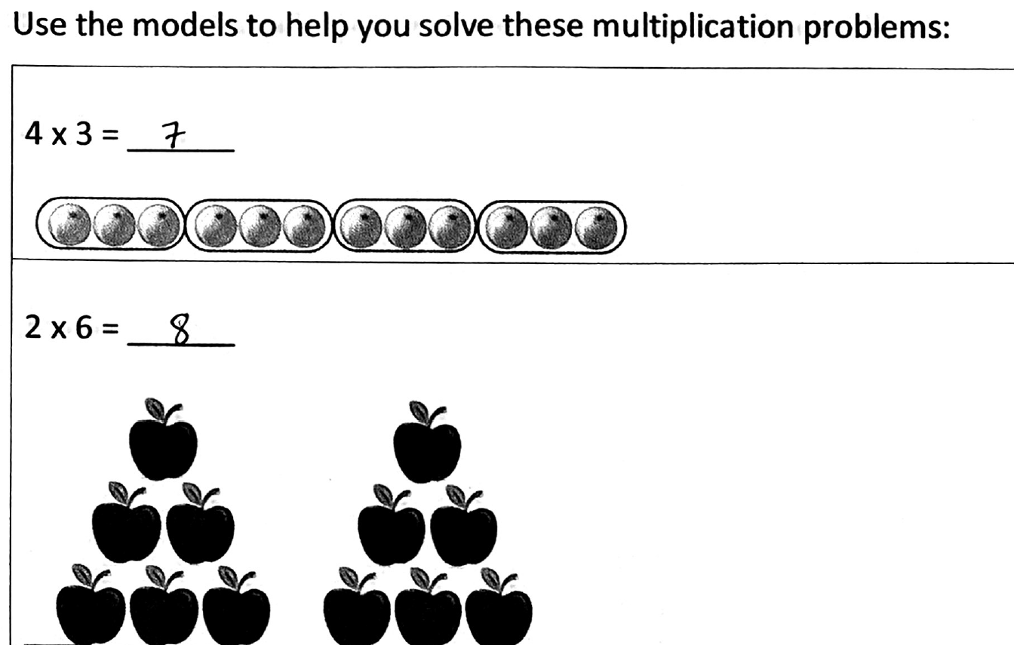
Use the student work to place students
92
Notes:
This is just a snip to help participants identify the ISP work sample document. These are found on pages 13-22 in the Teacher Orientation Manual.

Slide 93
Where would you place the students?
 | Add 4-digit numbers (Problem #7) | Subtract 4-digit numbers (Problem #9) | Regrouping (Problems #8 and #10) | Multiplication when given manipulatives(1st 3 problems) | Multiplication without manipulatives (2nd 3 problems)
Elias
Vanessa
Josh
Reina
Maria
3rd Grade Math Students’ ISP Levels
93
Notes:
10 min. work time
Trainer talk:
As you review the student work, you will be looking for evidence of the following specific skills in each student’s work sample. These are listed in the top row of the table.
Adding 4 digit numbers
Subtracting 4 digit numbers
Regrouping (formerly known as “borrowing” and “carrying”)
Multiplication when given a picture or manipulatives
Multiplication when there are no pictures or manipulatives
Some students demonstrate skill in just a few of these, some demonstrate skill in all of them and some do not demonstrate skill in any of them.
You have 10 minutes to review student work, and we will ask you to rate each student on a scale of 1-4 regarding their ability level with each of these 5 skills. If you were doing this as the teacher, you would have developed a rubric or a system that would describe what each level would like be, but in this case, we’re just practicing assigning a level so you will think generally on a scale of 1-4.
After 10 minutes, have participants indicate the rating on the chart at the top of p. 23 in the Teacher Orientation Manual.
Choose 1 or 2 participants work to highlight and have them talk through their answers.

Slide 94
Where did you place the students?
 | Add 4-digit numbers | Subtract 4-digit numbers | Regrouping | Multiplication when given manipulatives | Multiplication without manipulatives
Elias | 4 | 1 | 1 | 1 | 1
Vanessa | 3 | 3 | 3 | 4 | 2
Josh | 4 | 4 | 4 | 4 | 4
Reina | 3 | 1 | 1 | 2 | 1
Maria | 4 | 4 | 4 | 4 | 2
3rd Grade Math Students’ ISP Levels
94
Notes:
2 min.
Review the answers. Explain some of the nuances.
For example:
Vanessa and Josh both got all of the addition and subtraction problems correct. However, Vanessa had to draw extensive pictures/graphs/diagrams in order to get the correct answers, whereas Josh appears to have internalized these processes. That’s why Vanessa received a 3 in these tasks, but Josh received a 4.

Slide 95
SLO Skill Focus
SLO Skill Focus | SLO Skill Focus: Students will be able to recall basic multiplication and division facts with fluency and accuracy and apply their understanding of multiplication and division to solve one and two-step word problems.
Level | Descriptors | Students in this level
Well above typical skill | Students can multiply independently but are not able to use multiplication skills to solve one or two step word problems. | Josh
Above typical skill | Students can add and subtract four-digit numbers with accuracy and multiply some numbers independently, without support | Maria
Typical skill | Students can add and subtract four-digit numbers with accuracy and multiply some numbers when given support like manipulatives. | Vanessa
Below typical skill | Students can add and subtract four-digit numbers with difficulty and often without accuracy. Students understand groupings of numbers but cannot multiply numbers. | Reina
Well below typical skill | Students can add four-digit numbers but struggle with subtraction and regrouping. | Elias
95
Notes:
3 min.
Explain that based on the evidence we just reviewed, these are the skill levels on the ISP that each of these students mapped to.
Allow participants 1 minute to read the slide, then open the discussion for 2 minutes to take reactions/thoughts/questions.

Slide 96
Share Your Learning
Discuss the following two questions:
What is the purpose of the ISP?
How can having baseline information about student skill levels assist teachers to support student growth?
How can this data help appraisers, coaches, and colleagues in teacher growth conversations?
Notes:
5 min. table groups/breakout rooms to discuss each question.
Possible Answers (actual answers on next slide):
To ground the determination of entering students’ skill levels in the students’ actual work
Having evidence based information about students’ entering skill levels helps the teacher know where to focus and even fine tune instruction for students. This will maximize student growth by focusing on where in particular student skill deficits lie.
Baseline information focuses teaching approaches (and conversations about those approaches) in concrete, evidence-based information and thus, are more effective.
Upon return to whole group, have participants to share their answers to these questions.
Options for sharing:
Collab Board in Nearpod
Jamboard in Google
Choose a few volunteers to share verbally

Slide 97
Share Your Learning – 2
What is the purpose of the ISP?
To make evidence-based decisions about students’ entering skill levels.
How can having baseline information about student skill levels assist teachers to support student growth?
Knowing student skill levels, how they apply skills as well as how they approach tasks, is key to effective instructional planning.
Notes:
2 min.
As a summary of what was just shared by participants, here are some key points.
Trainer or a volunteer reads slide.

Slide 98
Reflections – 4
What are your key takeaways from this section on mapping students to the ISP?
Notes:
4 min. total
2 min.
Have participants spend two minutes in silent writing on their loose notes document capturing their key takeaways from this section of the training, and from Day One overall.
2 min.
Ask a few participants to share out verbally.

Slide 99
Key Takeaways – 4
Mapping Students to the ISP
Differentiates student skills
Based on close analysis of student work
Highlights the students you have and what they are able to do when they arrive at BOY
Allows for more effective planning
Notes:
2 min.
Trainer talk:
Here are the key takeaways we landed on.

Slide 100
Day 2
Notes:
1 min.
Welcome participants to Day 2 of Texas SLO training.

Slide 101
Welcome! – 2
In the bottom left corner find the microphone icon. If you aren’t already muted click the icon once to mute yourself.
In the bottom left corner of your screen, please turn on your camera if you are able.
Locate your participant video and click on the “more” icon to rename yourself. Include first name, initial of last name, and current role. Example: Theresa M, Principal
101
Notes:
SKIP THIS SLIDE IF TRAINING IN PERSON
Review Zoom courtesy and expectations.

Slide 102
Day 2 – 2
Writing Quality SLO Skill Statements
Writing Quality Initial Skill Profiles (ISP)
Matching Students to the ISP
Writing Quality Targeted Skill Profiles(TSP)
SLO Form/Beginning of Year Conference
Collecting a Valid Body of Evidence (BOE)
Student Growth Tracker
SLO Mid-Year Conferences
Determining End of Year Skill Levels Based on BOE
EOY Conferences
102
Notes:
1 min.
Trainer talk:
Yesterday we cover steps 1-3 of this process. Today we will be going through the remaining steps to complete Phase 1 and then we will cover Phase 2 & 3.
4. Writing Quality Targeted Skill Profiles(TSP)
5. Revised SLO Form/Beginning of Year Conference
Phase 2 includes:
6. Collecting a Valid Body of Evidence (BOE)
7. Student Growth Tracker
8. SLO Mid-Year Conferences
And Phase 3 includes:
9. Determining End of Year Skill Levels Based on BOE
10. EOY Conferences
During day 1 we will cover steps 1-3 or part of Phase 1. On Day 2 we will cover the remaining steps in the process, finishing Phase 1, and covering all of Phase 2 & 3.

Slide 103
A Takeaway From Day 1…
Writing Quality SLO Skill Statements
Writing Quality Initial Skill Profiles (ISP)
Matching Students to the ISP
Notes:
4 min. or less
Use as a warm-up/reconnecting activity.
Trainer talk:
Yesterday we spent a lot of time digging into these three initial steps of Phase 1.
Take a moment to consider an “aha” or a takeaway that you have regarding one of these steps.
Let’s take a moment to think about it then we will share.
(30 seconds think time)
3. mins to share with an elbow partner at the table or share in chat.

Slide 104
Google Folder Materials - 2
Google Folder Materials
*Insert guidance/screenshot on how to access folder of materials*
Notes:
Modify as needed

Slide 105
The Targeted Skill Profile (TSP)
Notes:
<1 min.

Slide 106
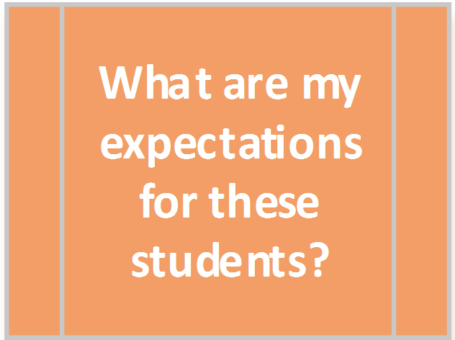
What are my expectations for these students?
Notes:
1 min.
Trainer talk:
We are ready for Question 3. So far we have determined our focus for the year through our Skill Statement, looked at what skills we thought students would have in relation to our Skill Statement by writing our ISP, and then mapped where our students actually were in relation to the ISP. Now it’s time to decide where we think our students can go with this SLO by the end of the year and set a growth goal for them.

Slide 107
Targeted Skill Profiles
The Initial Skill Profile captures students as they arrive in your class prior to your instruction.
The Targeted Skill Profile describes what you expect of students at the end of the SLO.
They are NOT the same.
Notes:
2 min.
There are big differences between the Initial Skill Profile and the Targeted Skill Profile. Teachers should not create a single profile and use it for both. This is a temptation many folks have – write it and just have students move up one level for growth. The ISP is really about what students can do before ever really having any instruction from the teacher. That is the purpose it serves and essentially after you have used it and are ready to build your TSP, the ISP is no longer is important as it has fulfilled its purpose. The TSP is all about now that I know these students, after a year of my instruction, how far can I push them.
The skills students exhibit on day one should be different than the skill they will be able to demonstrate at the end of the year.
Think of it this way – if I were measuring a child’s skill at swimming – maybe on Day 1, all they can do is get in the pool and cling onto the side. Maybe they will put their head in the water for a moment or two (and then gasp for air). I need to know that as a swimming teacher to know where to start. Once I know that information, I am ready to move on and figure out how much they can learn in the 4 months I have them. After the 4 months of swim lessons – they are able to do the breaststroke, freestyle, etc. These are not the same skills at all.
In academics it is the same. They are writing paragraphs in response to a prompt on Day 1, but on Day 180 maybe they are researching and supporting their work with evidence from the works cited.

Slide 108
Targeted Skill Profiles – 2
The Targeted Skill Profile captures the skill levels of where you think your students will be at the end of the year.
Targeted Skill Profile (TSP):
A means for considering long term goals for students
Based on the distribution of skills seen in the students actually in the class
Describe what skill level your students should display at the end of the course
Notes:
3 min.
This is the step where the teacher is going to build a Targeted Skill Profile (TSP). The teacher has spent 6+ weeks getting to know their students. The teacher knows the students’ skills as they relate to the Skill Statement and the teacher is really getting to know the whole child…..how they have performed, their attendance record, how they learn and respond, etc. At this point, the teacher is able to say that: I can see how far I can push them after a year of my instruction.
While a TSP is similar in structure to the ISP, note that the purpose is completely different. The teacher uses an ISP to really find out who is in the classroom, while a TSP is really the road map for growing all of the students.
And now -- as the teacher begins to think of how far they can take their class, the teacher would want to establish a ‘typical end of year skill level’ – a description that would fit the goals for the largest group of students at the end of the year. The teacher wants to build a TSP with the goal of a bell curve. This may seem counterintuitive to some – but the teacher should have in mind an idea of where the students with the highest and lowest skill levels should land at the end of the year, in addition to an idea where “most” of the students will land. This allows for the teacher to push and grow students in a way that allows them to focus on the skills that they gain in an honest, realistic way while still pursuing those high expectations of all students without expecting all students to reach the same outcome level. If you have students who are two or three grade levels behind in performance – the profile should reflect that.
Similarly, if the teacher has students who are well above grade level – the end of year skill profile should reflect a higher expectation of performance.
The targeted student skill profile is based entirely on the students in the class. Based on where these students started, what are reasonable goals regarding the skill statement by the end of the year?
It is possible and perfectly acceptable for a student to be rated Typical on the ISP and Typical on the TSP. This will still show growth because the profiles are different. The Typical description would be of a higher, more sophisticated level of performance on the TSP.

Slide 109
Core Idea – 6
Classroom and campus cultures that make some of the biggest gains in student growth do so by moving their focus from “what was taught” to “what was learned.”
Notes:
1 min.
Trainer talk:
This brings us to our next core idea.
Read this slide and let it sit for a moment.
Trainer talk:
Very simply, our most effective teachers don’t measure success by what was covered, they measure it by what was learned.

Slide 110
Success Criteria for Writing an Effective Targeted Skill Profile
Articulates skills for the end of the year
Differentiates between levels
Descriptors align to skill statement
Can be assessed in multiple ways
Targets are specific to the students in the teacher’s class and based on multiple sources of evidence
Reflects high, yet reasonable expectations for student growth
110
Notes:
1 min.
Trainer talk:
As with all parts of the SLO process, there are Success Criteria for a Targeted Skill Profile. Take one minute to reach each of the 6 Success Criteria for a TSP. This also can be found on p. 24 of the Teacher Orientation Manual.

Slide 111
Targeted Skill Profile: Exemplar
8th Grade ELA Skill Statement: Students will be able to draw accurate conclusions supported by appropriate textual evidence from informational texts
Well Above Typical Skill | Students can draw accurate conclusions from above grade-level informational texts and support conclusions with optimal evidence that deepens conclusions.
Above Typical Skill | Students can draw accurate conclusions from above grade-level informational texts and support conclusions with appropriate although not always optimal evidence.
Typical Skill | Students can draw accurate conclusions from grade level informational texts and support conclusions with appropriate although not always optimal evidence.
Below Typical Skill | Students can draw accurate conclusions most of the time from grade-level informational texts and attempt to support conclusions with textual evidence, but the evidence isn’t always appropriate.
Well Below Typical Skill | Students can draw accurate conclusions some of the time from grade-level informational texts, but don’t attempt to support conclusions or, when prompted, support conclusions with inappropriate evidence.
111
Notes:
3 min. total
Trainer talk:
This is an exemplar TSP.
It can be found on p. 25 of the Teacher Orientation Manual.

Slide 112
Key Differences: TSP & ISP
Read TSP on p. 25 - Teacher Orientation Manual
Compare with the ISP on p. 6
Consider questions and jot thoughts on p. 50:
What are some key differences between the ISP for this course and the TSP?
How does this TSP align to the Success Criteria for a TSP?
Notes:
3 min. total
Trainer talk:
Take 2 minutes to read all 5 skill levels of this TSP. Then go back and re-read the ISP for this same course, which can be found on p. 6 of Teacher Orientation Manual.
After reading time, take 1 min. to answer the following questions in your notes space. You have an open notes space for TSP on p. 50 of your manual:
What are some key differences between the ISP for this course and the TSP? Jot down in your notes the differences you see. We will come back to this later.
How does this TSP align to the Success Criteria for a TSP?

Slide 113
Targeted Skill Profile
Skill Statement 8th ELA: Students will be able to draw accurate conclusions supported by appropriate textual evidence from informational texts
Success Criteria of a TSP
Articulates skills for the end of the year
Differentiates between levels
Descriptors align to skill statement
Can be assessed in multiple ways
Targets are specific to the students in the teacher’s class and based on multiple sources of evidence
Reflects high, yet reasonable expectations for student growth
Partial TSP | Skill Descriptors
Above Typical Skill | Students can draw accurate conclusions from above grade-level informational texts and support conclusions with appropriate although not always optimal evidence.
Typical Skill | Students can draw accurate conclusions from grade level informational texts and support conclusions with appropriate although not always optimal evidence.
113
Notes:
2 min.
Ask participants to identify which success criteria on the left are fulfilled with the skill descriptors from the TSP on the right. They should make note of any success criteria that may not be clearly included in the skill descriptors on the right.

Slide 114
Targeted Skill Profile – 3
Skill Statement 8th ELA: Students will be able to draw accurate conclusions supported by appropriate textual evidence from informational texts
Success Criteria of a TSP
Articulates skills for the end of the year
Differentiates between levels
Descriptors align to skill statement
Can be assessed in multiple ways
Targets are specific to the students in the teacher’s class and based on multiple sources of evidence
Reflects high, yet reasonable expectations for student growth
Partial TSP | Skill Descriptors
Above Typical Skill | Students can draw accurate conclusions from above grade-level informational texts and support conclusions with appropriate although not always optimal evidence.
Typical Skill | Students can draw accurate conclusions from grade level informational texts and support conclusions with appropriate although not always optimal evidence.
114
Notes:
2 min.
Trainer talk:
The question mark on the 5th Success Critera is because we want to take the time to understand if the targets the teacher set, truly are based on her actual students and backed up by multiple sources of data.
Notice that in the “above typical” skill descriptor there is a reference to above grade-level texts, even though ‘above grade level texts’ is not specifically mentioned in the skill statement. This is because for this teacher with this group of kids, she feels strongly that based on where some of her students started the year, they will be able to demonstrate the skill of drawing conclusions supported by textual evidence, not just with texts at the 8th grade level, but with texts that are on an above 8th grade reading level. During some years. a teacher’s students may truly be able to be at this level by the end of the year, and other years, depending on where that particular group of students began the year, “above typical” may still be demonstrating this skill with grade level texts only.

Slide 115
Targeted Skill Profile – 4
Skill Statement 8th ELA: Students will be able to draw accurate conclusions supported by appropriate textual evidence from informational texts
Success Criteria of a TSP
Articulates skills for the end of the year
Differentiates between levels
Descriptors align to skill statement
Can be assessed in multiple ways
Targets are specific to the students in the teacher’s class and based on multiple sources of evidence
Reflects high, yet reasonable expectations for student growth
Partial TSP | Skill Descriptors
Below Typical Skill | Students can draw accurate conclusions most of the time from grade-level informational texts and attempt to support conclusions with textual evidence, but the evidence isn’t always appropriate.
Well Below Typical Skill | Students can draw accurate conclusions some of the time from grade-level informational texts, but don’t attempt to support conclusions or, when prompted, support conclusions with inappropriate evidence.
115
Notes:
2 min.
Trainer talk:
Take two minutes to consider, to which success criteria on the left do the skill descriptors from the TSP on the right align?

Slide 116
Targeted Skill Profile – 5
Skill Statement 8th ELA: Students will be able to draw accurate conclusions supported by appropriate textual evidence from informational texts
Success Criteria of a TSP
Articulates skills for the end of the year
Differentiates between levels
Descriptors align to skill statement
Can be assessed in multiple ways
Targets are specific to the students in the teacher’s class and based on multiple sources of evidence
Reflects high, yet reasonable expectations for student growth
Partial TSP | Skill Descriptors
Below Typical Skill | Students can draw accurate conclusions most of the time from grade-level informational texts and attempt to support conclusions with textual evidence, but the evidence isn’t always appropriate.
Well Below Typical Skill | Students can draw accurate conclusions some of the time from grade-level informational texts, but don’t attempt to support conclusions or, when prompted, support conclusions with inappropriate evidence.
116
Notes:
2 min.
Trainer talk:
Again, we have a question mark for the 5th Success Criteria to signal that this needs to be conversation with the teacher. What evidence sources did they use? How did they incorporate the students’ ISP levels when considering where to place students’ expected end of year skill level on the TSP?

Slide 117
TSP Compared to ISP
Initial Skill Profile
Targeted Skill Profile
Above Typical Skill
Students can summarize the most significant information with grade level informational texts and often make accurate inferences, although they struggle to connect inferences with appropriate textual evidence.
Typical Skill
Students can comprehend grade level informational texts with consistent success summarizing the most significant information, although students often
fail to make accurate inferences.
Above Typical Skill
Students can draw accurate conclusions from above grade-level informational texts and support conclusions with appropriate although not always optimal evidence.
Typical Skill
Students can make accurate inferences and draw accurate conclusions from grade level informational texts and support conclusions with appropriate although not always optimal evidence
Notes:
4 min. total
Trainer talk:
Now we will come back to any of the differences you noted between the ISP for this course and the TSP for this course.
Have participants read the Above Typical skill level on the TSP.
(Click)
Then have them read the Above Typical skill level on the TSP and compare the two. How are they different? If a student demonstrated the Above Typical skill level shown in the ISP in the beginning of the year, and then ended up at the end of the year with Above Typical on the TSP, would there have been growth?
(Click)
Have participants read the Typical Skill level on the ISP.
(Click)
Then have them read the Typical skill level on the TSP and compare the two. How are they different? If a student demonstrated the Typical skill level shown in the ISP in the beginning of the year, and then ended up at the end of the year with Typical on the TSP, would there have been growth?

Slide 118
TSP Compared to ISP – 2
Initial Skill Profile
Targeted Skill Profile
Below Typical Skill
Students can comprehend grade level informational texts but struggle to summarize the most significant information.
Well Below Typical Skill
Students struggle to comprehend grade level informational texts and are generally unable to summarize the most significant information.
Below Typical Skill
Students can draw accurate conclusions most of the time from grade-level informational texts and attempt to support conclusions with textual evidence, but the evidence isn’t always appropriate.
Well Below Typical Skill
Students can draw accurate conclusions some of the time from grade-level informational texts, but don’t attempt to support conclusions or, when prompted, support conclusions with inappropriate evidence.
Notes:
4 min.
Slide transitions on each click.
Have participants read the Below Typical skill level on the ISP.
(Click)
Then have them read the Below Typical skill level on the TSP and compare the two. How are they different? If a student demonstrated the Below Typical skill level shown in the ISP in the beginning of the year, and then ended up at the end of the year with Below Typical on the TSP, would there have been growth?
(Click)
Have participants read the Well Below Typical Skill level on the ISP
(Click)
Then have them read the Well Below Typical skill level on the TSP and compare the two. How are they different? If a student demonstrated the Well Below Typical skill level shown in the ISP in the beginning of the year, and then ended up at the end of the year with Well Below Typical on the TSP, would there have been growth?

Slide 119
TSP Exemplar: 5th Grade Science
On your own, read the 5th Grade TSP Exemplar on p. 24 of Teacher Orientation Manual.
What do you notice?
How does it align to the Success Criteria for TSPs?
Jot down responses to these questions and prepare to discuss.
119
Notes:
7 min. total:
2 min. to read
3 min. in table groups/breakout rooms
2 min. to share out
2 min. read
Have participants read the 5th grade Science TSP Exemplar on p. 24. Ask them to consider how this exemplar aligns to the Success Criteria for a TSP listed at the top of page 24 (and on the next slide).
3 min. small group discussion
Invite participants to discuss this TSP and how it aligns to the Success Criteria with a small group (table group/breakout).
2 min. whole group share
Return to whole group and ask participants to share where they found alignment in this particular TSP to the Success Criteria for TSP.

Slide 120
Success Criteria for Writing an Effective Targeted Skill Profile – 2
Articulates skills for the end of the year
Differentiates between levels
Descriptors align to skill statement
Can be assessed in multiple ways
Targets are specific to the students in the teacher’s class and based on multiple sources of evidence
Reflects high, yet reasonable expectations for student growth
120
Notes:
1 min.
Success Criteria for TSP for reference/review

Slide 121
Targeted Skill Profiles: Non-Exemplars
Individually read your assigned Non-Exemplar TSP p. 26-29 (3 min.)
Be prepared to discuss in groups: (5 min.)
Where are the gaps in order to align to the Success Criteria?
What probing questions would you ask the teacher in order to strengthen these TSPs?
121
Notes:
16 min. total
Organize participants in groups/rooms and assign non-exemplar TSPs to groups/breakout room by number. The total number of groups will be determined by number of participants in training. Try to have at least group for each non-exemplar.
Example:
Groups/Rooms 1-3 take the first non-exemplar: 7th Grade Science - p. 26.
Groups/Rooms 4-6 take the second non-exemplar: Culinary Arts – p. 27.
Groups/Rooms 7-9 take the third non-exemplar: French I - p. 28.
Groups/Rooms 10-12 take the fourth non-exemplar: 3rd Grade Math – p. 29.
Set a purpose for reading by reviewing discussion questions on the slide aloud.
3 min. - Silent/Solo
Give participants 3 minutes on their own to read their assigned Non-Exemplar TSP on p. 26-29 of the Teacher Orientation Manual and identify the gaps in how they align to the Success Criteria, as well as probing questions they would ask the teacher.
5 min. - Small group/breakout room
Organize participants in groups/rooms for five minutes to discuss.
4 min. - Share out from four groups/rooms (1 min. for each non-exemplar).
Back in whole group, ask one room from each assigned non-exemplar to briefly share the gaps they found and the questions they would ask the teacher on a Nearpod Collaboration Board.
4 min - Stamp gaps for each TSP.
Example gaps for each TSP:
7th grade science –Does it reflect high expectation? (Does well below typical from ISP to TSP reflect reasonable growth?) Is there appropriate differentiation between levels? (The gap between below typical and well below typical seems large.) Is it assessable? (how will the teacher reconcile all those subcomponents in the levels? How do you bring all of those together in measurement?)
Culinary arts –There is a lack of high expectations (well below seems like a very low bar at the end of the course). Descriptors do not align to skill statement (table presentation pops in and out of the descriptors)
French I- There is no evidence of skill being assessed in multiple ways. This TSP relies only on a single exam.
3rd Grade Math– Skill levels describe graphs and tables, which may be another part of 3rd grade math, but does not align to the Skill Statement.

Slide 122
Revising TSP Descriptors
SLO Skill Statement: Students will be able to apply comprehension of French I vocabulary and structures in order to converse in a culturally appropriate way about everyday topics such as greetings, food, family, etc.
Before
After
Typical | On the final exam, students respond to the majority of written and oral questions about culture (presented in French) with French 1 vocabulary words and largely appropriate grammatical structure, including proper use of the present, past and future tenses. Sentences are brief. Oral responses are grammatically correct but diction and inflection are weak.
Typical | Students can participate in spoken conversations in French on a variety of familiar topics. Students can ask and answer questions in basic French using French I vocabulary and structures with minimal errors.
122
Notes:
3 min. total
2 min.
Teacher talk:
This is an excerpt of the Non-Exemplar TSP for French I, which can be found on p. 28 in the Teacher Orientation Manual. Review the Skill Statement. Then read the “before” version for Typical Skill level at the end of the year, and the “after” version. What do you notice?
1 min.
Invite a couple of volunteers to briefly share some differences noted or use chat if delivering training virtually.

Slide 123
Revising TSP Descriptors – 2
SLO Skill Statement: Students will be able to apply comprehension of French I vocabulary and structures in order to converse in a culturally appropriate way about everyday topics such as greetings, food, family, etc.
Before
After
Above typical | On the final exam, students respond to most written and oral questions about culture (presented in French) with French 1 vocabulary words and appropriate grammatical structure, including proper use of the present, past and future tenses. Few errors are seen in grammatical structure and tense usage, uses complex sentences in responses. A few errors in diction and inflection occur in oral responses.
Above typical | Students can interact and respond to conversations in French on a variety of familiar topics. Students can ask and answer questions in basic French using French I vocabulary and structures as well as respond to questions on a variety of familiar topics.
123
Notes:
6 min, total
2 min.
Trainer talk:
Now let’s look at the Above Typical skill level “before” and “after” revisions. What changes do you notice?
How did the teacher go about revising the TSP skill descriptors?
How would you coach a teacher to do this?
2 min.
Trainer talk:
Now let’s take 2 minutes to think about that last question. How would you coach a teacher to revise the TSP.
What questions would you ask the teacher?
Be prepared to share your responses with the group.
2 min.
Group share out of how they would coach the teacher to revise the TSP.
They should land on the points identified on the next slide.

Slide 124
Steps to Revising TSPs
Start with the Skill Statement!
Do the skill descriptors align to the Skill Statement?
Is it clear that there will be multiple sources of evidence to determine end of year skill levels?
Is there enough range between the five skill levels?
Do all of the end of year skill descriptors represent significant growth compared to the beginning of the year skill descriptors?
124
Notes:
2 min.
Point out the steps for revising TSPs and how these can be used to coach teachers.
Mention that the Exemplar TSPs are a resource, as is the Success Criteria.

Slide 125
Activity
On your own, select any non-exemplar TSP on p. 18-21
Prepare and share
Based on the gaps, how would you rewrite this TSP so that it aligns to the Success Criteria?
125
Notes:
7 min.
Participants will select any one of the non-exemplar TSPs on pages 18-21. They have two options for this activity.
1. How would you coach this teacher to revise their TSP, so that it becomes an exemplar TSP that aligns to the Success Criteria?
Or
2. How would you rewrite this TSP so that it aligns to the Success Criteria? If they choose the coaching task, have them refer to the SLO/T-TESS crosswalk.
If they choose the rewrite option, have them refer to the exemplar TSPs and the success criteria for TSPs.
Framing: Some people feel that the best way to coach a teacher is to have done the work themselves. Others feel that being able to do the activity and being able to coach it can be two different things. Participants can select whichever activity they feel will lead them to being more qualified to coach teachers on SLOs.
Allow 7 minutes in silent/solo for this activity.
5 min. share out
Based on mode of delivery, plan ahead how participants will share their coaching questions or their “before/after” TSP.

Slide 126
One Example: Revised Culinary Arts TSP
Skill Statement: Students will be able to plan and prepare food commonly served in food service operations, aligned to USDA Standards, applying industry standard cooking techniques and using ACFE Standards for sanitation and safety.
Well above typical | Students can combine individual items commonly prepared in food service operations to plan and prepare all courses of a meal, using recipes as a guide and adding additional appropriate ingredients or seasonings as appropriate. Student uses equipment and techniques found in professional food settings. Students consistently apply appropriate sanitation safety standards.
Above typical | Students can combine individual items commonly prepared in food service operations to plan and prepare all courses of a meal accurately following recipes, using equipment and techniques found in professional food settings. Students consistently apply appropriate sanitation and safety standards.
Typical | Students are able to plan and prepare individual items commonly prepared in food service operations such as breakfast items, salads and dressings, soups and sandwiches, stocks and sauces, meats, vegetables, breads, rolls, and desserts. Students use a variety of cooking techniques and comply with all sanitation and safety standards.
Below typical | Students are able to plan and prepare individual items commonly prepared in food service, but not consistently. Students use basic cooking techniques consistently and more advanced cooking techniques inconsistently. Students comply with all sanitation and safety standards.
Well Below Typical | Students are able to plan and prepare some individual times commonly prepared in food service but not all and/or not consistently. Students use basic cooking techniques most of the time, but struggle with sequencing of steps for some techniques. Students generally comply with sanitation and safety standards, but still demonstrate some practices that are out of compliance some of the time.
126
Notes:
4 min. total
3 min.
Have participants compare the revised Culinary Arts TSP shown on this slide to the original non-exemplar Culinary Arts TSP in their Teacher Orientation Manual on p. 29. What has changed? Give them 3 minutes to jot down what has changed from the non-exemplar version to the Revised version.
1 min.
Invite a few volunteers to share aloud what has changed or share in chat.

Slide 127
A Resource to Review (and use later!) – 3
A document with the revised TSPs will be provided
127
Notes:
1 min.
Point them to the Revised TSPs document that has revised versions of all the Non-Exemplar TSPs.
https://texasslo.org/Resource_files/trainers/Revised_TSPs_from_non-exemplars.pdf
This is a trainer document so you will need to make a copy in Google to share electronically, or provide a hard copy.

Slide 128
Your Turn! – 3
On your own and using the SLO Skill statement and the ISP you wrote yesterday, write the TSP for your SLO on the SLO Form in your Google folder
You will have 15 minutes
Hint: use TEKS for your course as reference
Hint: Use the Success Criteria
Be prepared to share
You will use the TSP you create during the next part of the training
128
Notes:
20 min. total
15 min. to write
5 min. to share any exemplar work
Direct participants attention to the SLO Form they began writing on Day 1 (hard copy or in google folder). Allow 15 minutes for them to write. Advise participants to start with Typical skill level. Then move to Well Above and Well Below, and fill in Above and Below last.
As participants work, presenter monitors the folders if possible or monitors live work and selects 2 to share the TSP they wrote. (Note: ask the participants whose work you selected if they are ok with sharing it.)
5 min. for share out

Slide 129
Success Criteria for Writing an Effective Targeted Skill Profile – 3
Articulates skills for the end of the year
Differentiates between levels
Descriptors align to skill statement
Can be assessed in multiple ways
Targets are specific to the students in the teacher’s class and based on multiple sources of evidence
Reflects high, yet reasonable expectations for student growth
129
Notes:
2 min.
How did your TSP align to the Success Criteria?
Ask participants to read the TSP they just wrote and assess where it aligns to the Success Criteria for a TSP. One the next slide participants will be asked to share how well they think they did in a poll.

Slide 130
Setting Targeted Growth Goals
What are my expectations for my students?
Teachers set an individual targeted growth goal, using multiple data points for each student
Current class work/projects/tests & quizzes
Historical data
Attendance
Grades in other related classes
Test histories (where relevant)
130
Notes:
2 min.
Trainer talk:
The next step after writing the TSP end of year skill descriptors, is to set growth goals for each student.
Based on multiple sources of evidence, at what skill level do you expect your students to be at the end of the year?
What growth goal represents high, yet reasonable growth for each respective student?

Slide 131
Targeted Skill Profile: Exemplar – 2
8th Grade ELA Skill Statement: Students will be able to draw accurate conclusions supported by appropriate textual evidence from informational texts
Well Above Typical Skill | Students can draw accurate conclusions from above grade-level informational texts and support conclusions with optimal evidence that deepens conclusions.
Above Typical Skill | Students can draw accurate conclusions from above grade-level informational texts and support conclusions with appropriate although not always optimal evidence.
Typical Skill | Students can draw accurate conclusions from grade level informational texts and support conclusions with appropriate although not always optimal evidence.
Below Typical Skill | Students can draw accurate conclusions most of the time from grade-level informational texts and attempt to support conclusions with textual evidence, but the evidence isn’t always appropriate.
Well Below Typical Skill | Students can draw accurate conclusions some of the time from grade-level informational texts, but don’t attempt to support conclusions or, when prompted, support conclusions with inappropriate evidence.
131
Notes:
1 min.
Trainer talk:
Take a minute to review the TSP for 8th grade Language Arts. We will use this as an example for setting targeted growth goals. You can also find this exemplar on p. 25 of the Teacher Orientation Manual.

Slide 132
What are my expectations for these students? – 2
Student | ISP Level | Evidence | Targeted EOY Skill Level
Maria | Well Above Typical Skill | Typically is the highest performing student in her grade. Low absenteeism. Excels in all classes. Works hard and asks lots of questions. Attends tutoring to deepen her understanding | Well Above Typical Skill
132
Notes:
1 min.
Trainer talk:
Maria is known to consistently be the highest performing student in the grade level. She has low absenteeism and excels in all of her classes, showing a strong propensity to learn and grow. She works very hard and consistently asks questions or attends tutoring when she needs concepts reinforced. So maybe we decide that the skill description in Well Above Typical would be expected growth for her.

Slide 133
What are my expectations for these students? – 3
Student | ISP Level | Evidence | Targeted EOY Skill Level
Kendrick | Typical Skill | Very good in Social Studies and other courses that focus on informational texts and writing. Strong ELAR grades and test scores from last year. Seems eager to learn. | Above Typical
133
Notes:
1 min.
Trainer talk:
Kendrick is really good in social studies and other courses that require a lot of written and verbal expression, and this teacher knows that students who are also good in these types of courses tend to grow more in this course. He also had strong grades in ELAR last year. Kendrick seems eager and quick to learn. Nothing else stands out in his other data to suggest Kendrick’s growth trajectory could be hindered. Knowing all of this, the teacher thinks she can move Kendrick to Above Typical.

Slide 134
What are my expectations for these students? – 4
Student | ISP Level | Evidence | Targeted EOY Skill Level
Felipe | Above Typical Skill | Picks up concepts quickly. Checks his work for accuracy. Self corrects, even if it slows him down a bit in order to improve his performance. Had spotty attendance last year, this year has improved. Asks for help and works well with others | Above Typical
134
Notes:
1 min.
Trainer talk:
In working with Felipe, the teacher notices that he picks up concepts quickly and will check his work for accuracy. He self corrects regularly and if he slows down a bit, he really increases his performance. He does tend to have spotty attendance last year but so far this year his attendance has improved. Felipe does ask for help and works well with others. While he tended to perform in the middle of the pack last year in all of his classes, he seems to be above the average this year. This teacher really feels she can push Felipe to higher expectations and if his attendance stays strong and with a little bit of support she can push him to Above Typical.

Slide 135
What are my expectations for these students? – 5
Student | ISP Level | Evidence | Targeted EOY Skill Level
Dayana | Well Below Typical Skill | Work at first showed weak ELAR skills, however work in other classes seems stronger. After she received her 504 and accommodations were put in place, she was able to work more independently, and able to draw more accurate conclusions. | Typical
135
Notes:
1 min.
Trainer talk:
Dayana initially looked as if she didn’t bring much skill to this course but her other data shows that she tends to do well in other subjects and even does well in past ELAR classes. After receiving her 504, Dayana is a student with Dyslexia and that matches the difficulty with reading that the teacher noticed during initial assessments. Once Dayana had her accommodations in place, she was able to be more independent, more accurate and she was able to draw much better conclusions. Understanding all of this and looking at the TSP, this teacher really feels like Dayana will be at the Typical level by the end of the year.

Slide 136
What are my expectations for these students? – 6
Student | ISP Level | Evidence | Targeted EOY Skill Level
Violet | Below Typical Skill | Tends to need more support than others to cement her understanding of big concepts. Struggles with transferring what she learned in one assignment to the next, which is true in her other classes too. English is not her favorite subject, and that affects her motivation, her confidence and her time on task in class. | Below Typical
136
Notes:
1 min.
Violet struggled at the beginning of the year. As the teacher has continued to watch her in a number of academic tasks, she notices that she tends to need more support than others to cement her understanding of bigger concepts. She struggles with transferring what she has learned in one assignment to the next. This is true in her other classes as well. ELAR isn’t really her favorite subject so her motivation, confidence and time on task tend to be less than in other classes. This teacher really feels like Violet will grow and improve but feels that she will be Violet by the end of the year. This will still represent significant growth for Violet.

Slide 137
What are my expectations for these students? – 7
Student | ISP Skill Level | Targeted EOY Skill Level
Maria | Well Above Typical Skill | Well Above Typical Skill
Kendrick | Typical Skill | Above Typical Skill
Felipe | Above Typical Skill | Above Typical Skill
Dayana | Well Below Typical Skill | Typical Skill
Violet | Below Typical Skill | Below Typical Skill
137
Notes:
1 min.
Trainer talk:
This teacher used multiple sources of data including current and historical data about the student, performance in other classes, attendance, levels of support needed to complete work, etc. to determine what expectations for growth would be appropriate for each student. That thought process was shared on the slides we just reviewed.

Slide 138
ISP Skill Level vs. TSP Skill Level
Below typical skill
ISP Below Typical Skill | TSP Below Typical Skill
Students can comprehend informational texts but struggle to summarize the most significant information. | Students can draw accurate conclusions most of the time from grade-level informational texts and attempt to support conclusions with textual evidence, but the evidence isn’t always appropriate.
138
Notes:
2 min.
Trainer talk:
Read the descriptor for Below Typical skill level on the ISP. Then read the descriptor for Below Typical skill level on the TSP.
How are they different?
Could a student who started the year at Below Typical on the ISP and ended the year at Below Typical on the TSP still have demonstrated growth?
Ask a volunteer or have all participants respond in chat:
How does the TSP version of Below Typical show growth compared to the beginning of the year Below Typical on the ISP?

Slide 139
Reflections – 5
What are your key takeaways from this section on writing a quality Targeted Skill Profile and setting specific, data-based growth goals for each student?
Notes:
2 min.
Silent/Solo
Have participants spend two minutes in silent writing on their notes p. 35/36 in the Partipant Manual capturing their key takeaways from this section of the training.
2 min.
Have participants share one of their key takeaways.
Options/suggestions for sharing:
Small group
Virtual - Nearpod Collaboration board or Google Hangout

Slide 140
Key Takeaways – 5
TSPs describe a variety of end of year student skill levels with respect to the Skill Statement.
Skills increase in sophistication between the ISP and the TSP.
Use multiple sources of data to set targeted EOY growth goals for each individual student.
Notes:
2 min.
Trainer talk:
Here are the key takeaways we landed on.

Slide 141
The SLO Form
Notes:
1 min.
Trainer talk:
Believe it or not you have completed most of the SLO Form. You have completed steps 1-3 by completing your Skill statement, ISP, and TSP
We are going to finalize the SLO Form by answering the questions for step 4 around differentiation, progress monitoring and colleague collaboration.

Slide 142
SLO Form: Step 4
Differentiation
Progress Monitoring
Colleague Collaboration
Notes:
2 min.
Trainer talk:
The SLO form asks 3 questions in step 4: A,B,C
A- The first asks teachers about how they will differentiate for the highest perf groups and the lowest performing groups and how the teacher will push them to reach their goals.
B- The second question asks the teacher to think about the strategies that they will use to monitor students progress towards goals AND how they are documenting the Body of Evidence for each student.
C- The final question asks teachers how they plan to conference with colleagues about student progress, and about sharing best practices etc.
We will go through a few exemplar answers.
As we go through A, B, and C, please take notes. These notes will be useful when you are given time to complete Step 4 on your own.

Slide 143
Differentiation
How will you differentiate instruction for those students who are in the highest performing group as well as those who are in the lowest performing group? How will you guide all students toward reaching their targeted growth goals?
Example: 8th Grade ELA
Reading supports for informational texts
Supplemental texts to build prior knowledge
Hold bi-weekly writing conferences
Refer to rubrics
Hold goal–setting conversations with students
Have students' complete individual trackers
Peer Tutoring
143
Notes:
4 min.
Trainer talk:
SLOs are a force-function for ensuring teachers are differentiating and give guidance to the thought process and plan for differentiation.
Great teachers meet students where they are and have push goals that challenge them and the whole SLO process is built around this idea.
Even though this is just one question in the SLO Form, teachers answer this question throughout the process.
This Step 4 aligns with the 8th Grade ELA skill statement.
(Read slide)
Again, I would love for you all to jot down notes and use them in your own step 4 so we can gather multiple ideas to differentiate in various subject areas.

Slide 144
Progress Monitoring
b. What strategies will you use to monitor progress? How will you document your body of evidence for each student?
Complete Student Growth Tracker after each piece of evidence is completed and scored
Strategic/Aggressive Monitoring – Monitoring student work in class to close gaps during instruction (laps!)
Hold bi-weekly writing conferences with individual students (groups of students working on the same writing skill)
Frequently revisit writing rubrics with students
Students share work in common folder
Data Meeting/Conferences
144
Notes:
2 min.
Trainer talk:
The SLO process causes leaders and teachers think through progress monitoring and tracking data.
(Read slide)
On an actual SLO Form completed by a teacher, we would like to see even more concrete examples. For example, if the teacher includes aggressive/strategic monitoring, they will also include “Lap 1- outline, lap 2- thesis, lap 3…etc.” (redirecting/collecting data).

Slide 145
Colleague Collaboration
c. Describe your plan for conferencing with your colleagues about student progress. Who will be members of your team and how often will you meet?
The writing teachers will meet bi-weekly in our after-school PLCs to share student work samples to calibrate scoring.
Discuss and share plans for differentiation based on student data.
Discuss non-academic struggles and success
145
Notes:
2 min.
Trainer talk:
Step 4 of the SLO form is very important because it allows for the teacher to consider when they will schedule time for collaboration with colleagues and for the administrators to ensure that this time is prioritized and built into the schedule/PLC time.
(Read slide)

Slide 146
Your Turn!
Individually (silent solo)
10 minutes
SLO Form
Complete Step 4 using your Skill Statement, ISP, and TSP
Notes:
10 min.
Trainer talk:
Individually, you will have 10 minutes to use the SLO Form to complete step 4. Remember to use your teacher lens as well as the administrator/appraiser lens when completing this step so that you can anticipate struggle.
Questions to consider:
Where do I believe teachers will need examples/techniques when answering these questions?
As a campus leader, if I expect SLOs to be done well, I need to ensure that my campus structure/culture/calendar aligns to teachers being successful and supported.
How will I do this?
Success Criteria: https://texasslo.org/Resource_files/resources/SLO_Success_Criteria.pdf

Slide 147
Reflection
How did you answer Step 4?
With which portion of Step 4 do you believe you will need the most support?
Notes:
3 min.
Trainer talk:
Take a minute to reflect on this question:
Which portion of Step 4 do you believe teachers will struggled with most/need the most support?
Please share out any of the thoughts you have around Step 4.

Slide 148
Beginning of Year Conference
In preparation for the meeting:
SLO Form
SLO Success Criteria
Examples of what will be included in Body of Evidence
Student Growth Tracker
SLO Rating Rubric
Instructional planning calendars
Notes:
2 min.
Trainer talk:
We are going to discuss how to prepare for the BOY conference.
Before even scheduling a conference, ask teachers to submit the completed SLO form and Student Growth Tracker(s), as well as any documentation that could support the SLO. This should include examples of what they will include in their body of evidence (BOE) at the end of the SLO interval to determine student growth.
Appraisers should review the teacher’s submitted SLO process using the SLO Success Criteria.
Appraisers will also review the examples of what the teacher has included in the Body of Evidence to ensure they are aligned.
Appraisers will need to approve the student growth tracker and the SGT should be filled out with the teacher’s name, course, and student names. The SGT may be more complete depending on the time of the BOY conference.
Appraisers will use the Rating Rubric to ground the conversation in the end goal for the teacher and students.
Another best practice is to ask teachers to share the Instructional planning calendars before the meeting so the appraiser can best see where each piece of the BOE will fall in the year as well as when to observe the teacher, check data, set up future meetings, etc.

Slide 149
BOY Document Review
Using the SLO Success Criteria, focus on the following when reviewing documents:
Foundational Skill Statement
Alignment to TEKS
Differentiation between Skill Levels
Appropriate Evidence
Rigor of Goals
Notes:
2 min.
Trainer talk:
Being prepared for the BOY conference is imperative to the success of the SLO process.
Using the SLO Success criteria in preparation for the BOY conference, the administrator will review the documentation and consider the following factors:
Thinking about the appropriateness of content selection
Is it a foundational skill?
Will it be addressed throughout the year?
Does it align to TEKS/standards?
Clarity in the skill profiles
Can one level easily be distinguished from the other?
Evidence
Are the measures appropriate for the content?
Expectations
Are the teachers’ expectations for growth rigorous but attainable?
Also, if the appraiser feels the SLO is not reflective of high yet reasonable expectations for student growth, or not grounded in sufficient evidence, return the SLO to the teacher, requesting revisions before the meeting. It may be best to meet briefly with the teacher to discuss your requests. If the changes are minor, they may be made during the conference to eliminate the need for another meeting.
Another best practice is to have reviewed all the documents and produce how YOU believe they should be revised and then go into the meeting with that pre-work complete so you can better guide the revisions and truly understand the process and be able to ask the right questions.

Slide 150
For Appraisers – BOY During Conference
Begin positive
Ask key questions
Put the thinking back on the teacher
Focus on strengths
Guide and coach on revisions
Review SLO Rating Rubric
SLO Process for teachers and students – both flexible, requires reflection, growth, revisions
Stamp next steps and timeline
Notes:
APPRAISER SLIDE –OPTIONAL SLIDE FOR TEACHERS
3 min.
Trainer talk:
When possible, combine the SLO conference with existing goal-setting and professional development planning conferences or fall semester observation pre-conferences. If that is not possible due to timing, consider reviewing common SLOs together in grade- level teams or content-area teams. Even if they do not share a common SLO, their SLOs are likely to be similar in focus, and working together as a team will help refine the SLOs.
Like with all feedback, and conferences with teachers, always start and end on a positive note. Encourage teachers by focusing on the strengths of the SLO as it currently stands. Ground the strengths in the success criteria.
The Conference Guide Document highlights the types of questions you might want to ask teachers during the beginning of the year conference:
How did you decide the focus are for your SLO?
What personal knowledge or experience led to the selection?
How did you use focus area to lead to a strong Skill Statement?
What data did you review to make the selection for a focus area?
How did it guide the Skill Statement?
How was the Initial Student Skill profile created?
How did you assign students to descriptors?
Were there any challenges in that process?
Select one or two students and ask about the targets set for them. Focus on targets that may not be consistent (higher or lower than others).
What factors went into making that differentiation?
What is the plan for instruction to address all of the students?
(Optional: You all produced some great questions yesterday so please add them into your list.)
During the BOY Conference, review the SLO Rating Rubric to be used by the district with the teacher. This will help them understand how their work with SLOs will be evaluated based upon the thoughtfulness of the SLO design, willingness to adapt instruction throughout the interval, student growth, and reflection on outcomes. This will also help reinforce that SLOs are a process, focusing not only on the end but also on monitoring and adjusting instruction throughout.

Slide 151
Your Turn! - 2
Individually
During video (and 2 minutes after)
Jot down
Strengths
Opportunities for Growth
Missing elements
Notes:
APPRAISER SLIDE –OPTIONAL SLIDE FOR TEACHERS
15 min.
Trainer talk:
We are going to watch the SLO BOY Conference video as a demonstration of some of the practices to use
Here are some example look fors:
Goals for teacher
Approach to planning SLO- multiple pieces of evidence
Draw from another piece of evidence
Written communication/Verbal communication
Analyzing information

Slide 152
BOY Conference
Notes:
APPRAISER SLIDE –OPTIONAL SLIDE FOR TEACHERS
https://educator-evaluation-and-leadership.wistia.com/medias/9z5t634ckk
(After video, provide this context)
From an overview lens, It is clear that the administrator knows the SLO process well and is fluent with all terms like Foundational Skill, ISP, TSP, etc. Clear that the teacher also knows the process well and has spent a lot of time reviewing her course content to select a strong Skill statement and reviewing her students’ work in order to place students on the ISP and TSP.
What are some strengths you noticed in particular?
*Share out strengths before advancing to the next slide.

Slide 153
BOY Conference Strengths
Foundational skill
Close alignment to the process for all steps
Intentional
Sets high expectations, grounded in actual student data and familiarity with students and their work
ISP/TSP aligned, differentiated across all levels
Coaching to improve the ISP distinction between Above Typical and Well Above Typical
Notes:
APPRAISER SLIDE –OPTIONAL SLIDE FOR TEACHERS
3 minutes
Some of you named similar strengths.
strengths:
Skill Statement - well-articulated on how it’s an important focus for 3rd grade math, and solid knowledge and evidence of the 3rd graders skills at the beginning of the year that will factor into their preparedness to master multiplication and division by the end of the year
Coaching - pushes teacher on how to more clearly differentiate the skills on the ISP between the Above Typical level and the Well Above Typical level.
Very intentional about how she will work with students in order to ensure they reach their expected growth target
Shows high expectations for students and their learning (wants to press on her kids)
Uses several data points to determine where students are at the beginning of the year on the ISP and where she expects them to be at the end of the year on the TSP
Reminder from appraiser about the importance of monitoring student progress along the way, and compiling data points in order to be ready for the MOY conference
Where did you see opportunities for growth?
*Share out opportunities for growth before advancing to the next slide.

Slide 154
BOY Conference Opportunities for Growth
Align to Success Criteria for
Skill Statement
ISP
TSP
Ask to see some of student work/evidence that teacher used
Selected only 3 students to review. Ideally would review evidence for 1-2 students per skill level
Notes:
APPRAISER SLIDE –OPTIONAL SLIDE FOR TEACHERS
2 min
Some of you named similar opportunities for growth…
Opportunities for Growth:
Appraiser did not align feedback to the Success Criteria for each of the steps: Skill Statement, ISP and TSP
Appraiser did not ask to see student work in order to view how the teacher used student work to determine placement on ISP and TSP
Appraiser asked only about 3 students (partly this was in the interest of time for the video), would have been a stronger conference if appraiser had asked/seen evidence for at least 1 student in each of the skill level bands, and ideally 2 per skill level band to get a more complete picture and set the teacher up for success to build the body of evidence.
Administrator needs to see multiple data sources (BOE) that depict each student's placement and targeted goal setting
**What questions/advice would you have for this appraiser if you were their coach/supervisor?

Slide 155
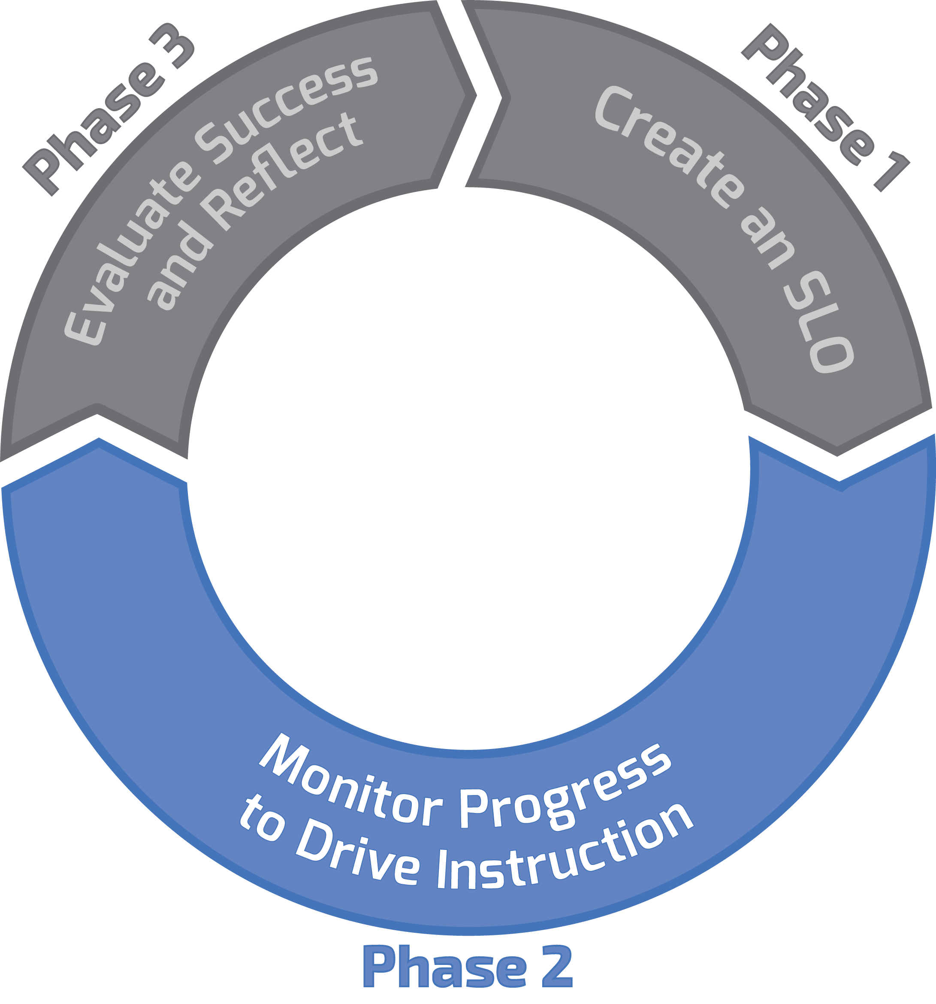
Three Phase Process
Notes:
1 min.
Trainer talk:
Now, we will focus on Phase 2 which is about monitoring progress to drive instruction and building a body of evidence of student work. Note that this covers most of the SLO interval. It is the longest part of the process where teachers and administrators are implementing what was created in Phase 1.

Slide 156
Building a Body of Evidence
Notes:
1 min.

Slide 157
Phase Two: Monitor Progress and Build the Body of Evidence (BOE)
Q: How do I assess student progress for my SLO?
A: With a robust Body of Evidence (BOE)
157
Notes:
1 min.

Slide 158
How will I guide these students towards growth?
Notes:
1 min.
Trainer talk:
The next of our 6 Big Questions is “How will I guide these students towards growth?” Note that it says “these” students. That is because in the SLO process all of the steps are about actual students you have in front of you and their actual skill levels as documented by multiple sources of evidence.

Slide 159
Body of Evidence – 2
Define what counts as a quality task/assessment/project in order to be considered part of the BOE
Set minimum number of data points to be included in the BOE, minimum five pieces of student work/evidence per student
Require BOE check-ins at least twice a year with teacher and appraiser
159
Notes:
1 min.
Trainer talk:
The body of evidence of student work will determine whether students met their targeted growth goals.
When reviewing the body of evidence consider these questions:
To what skill level in the TSP does the student work most closely align?
Which descriptors from which of the five skill levels are present in the student work?
The idea here is that the actual student work is the “proof” of what students learned and are able to do. Using the skills and behaviors outlined in the TSP as the lens through which to review the body of evidence of student work grounds the process in aligned evidence across multiple data points.

Slide 160
Body of Evidence – 3
SLO Skill Statement: Students will be able to draw accurate conclusions supported by appropriate textual evidence from informational texts
Assignment | Part of BOE?
1. In class claim/evidence essay (Sep)
2. “Explain your evidence”
3. “Supporting your claim” short answer
4. Haiku
5. Autobiography
6. In class claim/evidence essay (Feb)
7. Poetry journal
8. In class claim/evidence essay (Apr)
9. Final exam claim/evidence free response
Which assignments should be part of the BOE for this SLO?
160
Notes:
2 min.
Trainer talk:
Read the Skill Statement for 8th grade ELA. Which of the assignments on this list would likely be considered as good sources of evidence to measure this Skill Statement? Place a check mark or “Yes’ next to each assignment that you think should be included in the BOE for this SLO, and an X or “No” next to each assignment that should not be part of the BOE.
Note: For the purposes of this activity, you can assume that for each assignment that says, “claim and evidence essay” the essay is on an informational text.
Options for participant markings: Individual copies, Nearpod Draw it, or white space in notes.

Slide 161
Body of Evidence – 4
SLO Skill Statement: Students will be able to draw accurate conclusions supported by appropriate textual evidence from informational texts
Assignment | Part of BOE?
1. In class claim/evidence essay (Sep) | Yes
2. “Explain your evidence” | Yes
3. “Supporting your claim” short answer | Yes
4. Haiku | No
5. Autobiography | No
6. In class claim/evidence essay (Feb) | Yes
7. Poetry journal | No
8. In class claim/evidence essay (Apr) | Yes
9. Final exam claim/evidence free response | Yes
Which assignments should be part of the BOE for this SLO?
161
Notes:
3 min.
Conduct a whole group discussion.
Note that all of the assignments are valid assignments, and all are part of 8th grade ELA curriculum, but only some directly align to the Skill Statement.

Slide 162
Body of Evidence
Aligned to the Skill Statement
Measure students’ progress on the foundational skill
Includes assignments/projects/work products that tie directly to the Skill Statement
Does not include student work outside the scope of the foundational skill at the heart of the SLO

Slide 163
Your Turn! – 5
Using the SLO Skill statement, ISP, and TSP that you have written, create a list of assignments/assessments you would use for your BOE
Document on the SLO Form, under TSP, part d
Hint: make sure all assignments align to your Skill Statement!
Be prepared to share examples of your BOE
163
Notes:
9 min. total
4 min.individual work
Direct participants attention to the SLO Form that participants have been working on throughout the training. Participants should list potential sources of evidence they would use for the SLO they have been writing. If a teacher they were coaching were using the SLO, what sources of evidence would they expect the teacher to include? How would they coach for this? We will share in breakout rooms after 4 min of Silent/Solo.
5 min.small groups
Participants share with a partner their Skill Statement and the proposed student work for their BOE Each person in the room has 2 minutes to share their work, and then as a pair they will discuss how to coach this for teachers.

Slide 164
Student Growth Tracker
Notes:
1 min.

Slide 165
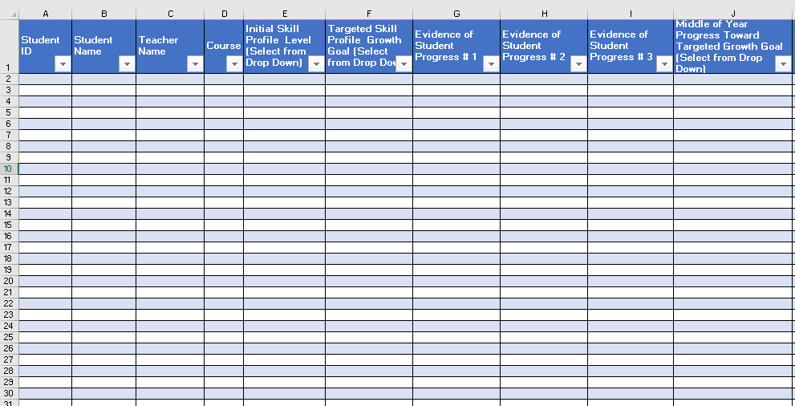
Student Growth Tracker – 2
Notes:
1 min.
This is an image or you can click on the link to open the live link, which participants will use on the next slide.
https://texasslo.org/Resource_files/resources/Student_Growth_Tracker.xlsx
Note: School may have a similar tracker to process growth but if not, they can use this resource. This tracker provides a digital option as well as an exemplar in the SLO resources. The district or campus should have a system for tracking the progress of SLOs and this tracker is provided as an option.

Slide 166
Student Growth Tracker – 3
Includes:
Initial Skill Profile Level
Targeted Skill Profile Growth Goal
Progress Monitoring Evidence
End of Year Student Skill Level
Representation of Growth
Mastery of assignments/evidence
Scoring 1-5
Scoring %
A-F
Notes:
2 min.
Trainer talk:
The Student Growth Tracker is a spreadsheet for the teacher to track data over time.
This can aid in discussions with teams and appraisers.
It tracks and monitors progress for students at multiple points so trends can be seen and discussions about changes or flat lines can be held to determine the best course of action.
This tracker should be referenced in all 3 conferences as well as checked on throughout the year: BOY MOY EOY and everything in between.
Another best practice to have this as a live document shared with observers and appraisers.
All student growth trackers should include:
Initial Skill Profile Level
Targeted Skill Profile Growth Goal
Progress Monitoring Evidence
End of Year Student Skill Level
Representation of Growth
Mastery of assignments/evidence

Slide 167
Student Growth Tracker – 4
A place to store data on student progress
Numbers are a placeholder for how the student work aligns to the skill descriptors on the TSP
Example: Assignment #1: Adding/Subtracting with Regrouping
What Skills Demonstrated in Student Work | What number goes on the tracker
A student can add/subtract without regrouping but can’t add/subtract with regrouping | The number on the tracker might be a 1 or a 2, because that is how the actual student work aligns to the TSP descriptors for that skill.
Notes:
2 min.
Trainer talk:
The Student Growth Tracker is a place to store data on student progress
The numbers are a placeholder for how the student work aligns to the skill descriptors on the TSP
Emphasize that teachers are mapping to skill statement.
Reminder: Be careful in trying to translate all this into a scale. SLOs are not about achievement, the process is focused on growth and progress.
BOE #1 may be graded a “3” but that would not be the same grading as BOE #3 because they have more knowledge further into the year.

Slide 168
Student Growth Tracker – 5
Notes:
1 min.
Trainer talk:
Before we hop into practice with this document, let me give you some instructions. I will share how to use this excel document.
https://texasslo.org/Resource_files/resources/Student_Growth_Tracker.xlsx
Got to the live spreadsheet via the link above and model going into first tab and filling in the cells so that they auto-populates into tab 2.
Instructions for using the SLO Student Growth Tracker:
Complete Tab 1 (Teacher name, Course, SLO Skill Statement)
Once Tab 1 is complete, Columns C and D will auto-populate in Tab 2
Fill in Columns A and B (Student ID, Student name) *You may use copy and paste from another Excel.
Columns E, F, J, M, and N have "drop down" features
Columns G, H, I, K, and L need to be manually complete with student scores
Add formula to Columns F and M to populate score into Column N Additional explanation may be needed for those who are not familiar with creating a formula in EXCEL, or you can direct them to work with a colleague who knows how to do this.

Slide 169
Your Turn! – 6
Open the Excel document
Complete the tracker for 5 sample students
Sources of data from BOE
Complete each column with score that reflects student skill level as it aligns to descriptors in the TSP
Teacher POV
Leader POV
Write down
Extra questions
Areas of greater support
Remember: You are entering numbers, but they are just “stand ins” for how the student work aligns to skill descriptors on TSP. Not about the numbers as much as about the skills.
Notes:
5 min.
Trainer talk:
Before you start, remember that this document can be modified/the district may have something similar but these key column headings in the Student Growth Tracker are needed on any tracking system used.
You will have 5 minutes to work on the Student Growth Tracker. Please complete the tracker for a sample 5 students, remembering your 5 pieces of evidence in the BOE
Enter student’s starting point on an individual basis.
Record progress check-ins after each BOE.
You can add columns to this sheet if desired.
At the end of year, teachers will return to record end-of-year level of learning.
Keep clear records to track progress.

Slide 170
Getting Students Involved
Guidance
Teacher scripts out full-class investment strategy
Why are we having these conversations?
Why is goal setting important?
Teacher scripts out individual conversations
Explain goal to student (based on data)
Brief conversation to invest student/create individual plan
Record goal
Teacher creates a tracker (example below)
Determine a place for students to record progress towards goals
Notes:
3 min.
Trainer talk:
SLOs can be a strong Student Growth Measure if done well. We discuss students and their individual skill levels SO much, but sometimes we fail to include students in this process. We have some guidance to support student involvement in tracking their own growth in case it can be helpful to introduce the process.
Another best practice is to involve students in the process by providing them with an individual tracker. Note that this can be done with all grade levels.
Why is it valuable to include students in the SLO process?
Expected response: Build student buy-in and intrinsic motivation
resource: https://texasslo.org/Resource_files/resources/Individual_Student_Tracker_Example.docx

Slide 171
Success Criteria
a. Plan/Differentiate
Considers highest and lowest skill levels in planning so that all students are supported to meet targeted growth goals
Challenges all students regularly -Uses evidence of student work/skill levels to drive planning
b. Monitor and Adjust
Assesses student progress on SLO at least twice per semester
Assessments are aligned to SLO Skill Statement in content and rigor
Adjusts pedagogy and lesson plans based on assessment results
Compiles a valid and reliable body of evidence of student work, aligned to the Skill Statement
c. Collaborate
Collaborates in order to ensure alignment with district and campus expectations
171
Notes:
2 min.
Trainer talk:
Again, as we do throughout the entire SLO process, we review the Success Criteria and align the BOE and student tracker to the criteria.

Slide 172
Middle of Year Conference
Monitor progress towards goals, coaching, response to data
Notes:
1 min.
Trainer talk:
The MOY conference is now included in the SLO process.
In this conference, administrators are providing guidance around progress monitoring, coaching teachers, and responding to data.

Slide 173
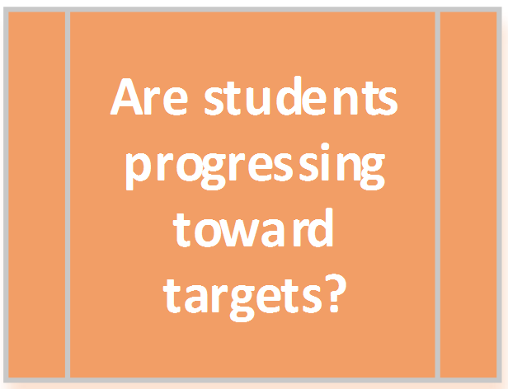
Essential Question
173
Notes:
1 min.
Trainer talk:
Here we are at our 5th question. Are students progressing toward their targets?

Slide 174
Middle of Year Conference – 2
In preparation for the meeting, review:
Student Growth Tracker
Student samples from the Body of Evidence
Data (number of students on track/off track to meet goals)
Notes:
2 min.
Trainer talk:
A best practice is to check-in during the school year to ensure teachers are supported in tracking student growth and monitoring progress towards goals.
Middle of Year Conference Practice:
The Conference form includes MOY Conference guidance.
Before the meeting, appraisers should have access to the Student Growth Tracker, Body of Evidence, student work samples, and the data.

Slide 175
MOY Document Review
Data- Student Growth Tracker alignment to student work samples
Side by side scoring of same pieces of student work
Notes:
APPRAISER SLIDE –OPTIONAL SLIDE FOR TEACHERS
2 min.
Before the MOY conference:
In advance of the meeting, the administrator/appraiser should ask teachers to submit the current Student Growth Tracker(s), including any assessments, essay prompts, lab instructions, and performance task directions. The administrator will review these documents and prepare questions for MOY conference the teacher.
Upon reviewing the tracker and assessments, ask the teacher to bring in student work on any of the measures the students have completed thus far. The goal will be to review a few samples of student work to determine how the work is being scored, where students are in relation to their goals and for the teacher to reflect on that progress.

Slide 176
MOY During Conference
Begin with positive feedback
Ask key questions
Deep dive into data
Guide and coach on revisions
Plan for students that are off track to meet growth goals
Set clear next steps and time to follow-up
SLO Process for teachers and students – both flexible, requires reflection, growth, revisions
Notes:
APPRAISER SLIDE –OPTIONAL SLIDE FOR TEACHERS
3 min.
Trainer talk:
During the Conference
1. Review progress on BOE (body of evidence) and look at student work/data so that the appraiser can be sure that the BOE (body of evidence) is on track to be as accurate and robust as possible to accurately measure student growth.
2. Encourage teachers to reflect on key questions centered on student growth, including: Based on the current evidence for each student:
Which students are on track to meeting their targeted growth goals?
What is the plan to address students that are off track?
3. Set a date and time to follow-up on the plan to address students who are off track within the next grading period.

Slide 177
MOY Conference
Notes:
APPRAISER SLIDE –OPTIONAL SLIDE FOR TEACHERS
https://educator-evaluation-and-leadership.wistia.com/medias/d76eqnyyla

Slide 178
MOY Conference Strengths
Reviewed Skill Statement
Used student work to frame discussion
Use of growth tracker
Reflective conversation/coaching around how to support students in the “danger zone”
Students have own trackers
Very clear next steps
Notes:
APPRAISER SLIDE –OPTIONAL SLIDE FOR TEACHERS
3 minutes
Some of you named similar strengths.
Strengths:
Reviewed Skill Statement to frame discussion
Administrator is encouraging and teacher embraces the process
Teacher mentions the growth tracker and that she already had 3 pieces of evidence per student
Teacher brought actual student work
Administrator asks teacher to reflect on her practice from beginning of the year until now and look for a connection between what her students are learning and consider why some of the students are in the “danger zone”, as well as what could be done to support them
Prior to the meeting, the administrator has scored 3 pieces of student work for 2 different students, using the TSP, and came out with the same skill levels at the teacher did
Students have their own trackers, which is proving to be motivating to them
Admin asks, “how can I support?”
Very clear next steps for both admin and teacher
Where did you see opportunities for growth?
*Share out opportunities for growth before advancing to the next slide.

Slide 179
MOY Conference Opportunities for Growth
Administrator walk through/model how she used the TSP skill levels to “score” student work to ensure alignment.
Emphasize,” I placed this student’s skill level here because…, not above this level because… and not below this level because…”
Review expectations for End of Year Conference
Notes:
APPRAISER SLIDE –OPTIONAL SLIDE FOR TEACHERS
2 min
Some of you named similar opportunities for growth…
Opportunities for Growth:
Administrator walks the teacher through how he/she used the TSP to determine the current skill level for each student. For example,”I placed this student’s work as Below Typical because…, and not at Typical because… and not at Well Below Typical because…” Including why the work aligns to one level and not the the level above or below will further ground the process in evidence and detailed analysis of student work
Review expectations for the End of Year conference.
**What questions/advice would you have for this appraiser if you were their coach/supervisor?

Slide 180
Determining EOY Skill Levels
Using Student work to determine end of year skill levels
Notes:
1 min

Slide 181
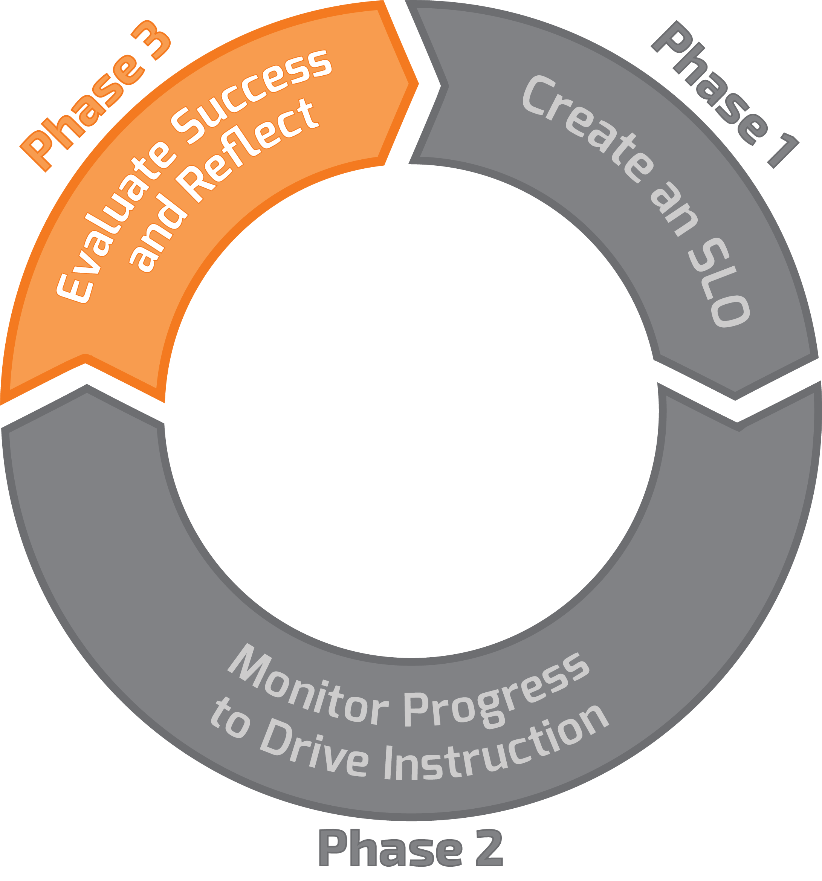
Three Phase Process – 2
Notes:
1 min.
Trainer talk:
Now we are ready to move to the last part of the process. Phase 3 -Evaluating Success and Reflecting on outcomes is the final phase in the cycle.

Slide 182
Did students grow and what did I learn from the process?
Notes:
1 min.
Trainer talk:
Here we are at Question 6. This is at the end of the process for the year. Did the students grow and what did I learn from the process?

Slide 183
What are my students’ EOY Skill Levels?
Teachers assess the end-of-year student skill level based on the Body of Evidence.
Based on the BOE, to which skill level on the TSP does each student’s work most closely align?
Student work is used to determine the skill level on the TSP.
Did students meet their targeted EOY skill level?
Notes:
1 min.
Trainer talk:
This is the time for teachers to review the students’ BOE to determine the skill level on the TSP to it most closely aligns. Once the teacher has determined the skill level descriptors that best describe the students’ work, the teacher can look back at the targeted skill level, set at the beginning of the year to see if the students met their growth goal or not.

Slide 184
Let’s go back to 3rd grade math…
Look at student work from EOY.
Based on this work, to which level on the TSP does the work of each student most closely align?
Notes:
2 min.
Direct participants attention to the document called “3rd Grade Math TSP Student Work.”
Trainer talk:
Look at 3rd grade TSP student work for each of our five sample 3rd grade math students. These work samples cover 5 different math skills:
Solving 1 and 2 step problems
Writing the equation
Justifying the answer, with support
Justifying the answer without support
Writing own word problems
Review the student work to determine how their work aligns to the skill levels described in the TSP.

Slide 185
Where would you place the students? – 2
 | Solve 1 and 2-step Mult. and Division word problems #1-#2 | Write the Equation #1-#2 | Justify answer with support #1-#2 | Justify answer w/o support #1-#2 | Write own word problems #3
Elias
Vanessa
Josh
Reina
Maria
3rd Grade Math Students’ ISP Levels
185
Notes:
1 min.
Trainer talk:
Looking at the work for all 5 students, determine the level of skill for each student across each of these 5 math skills. Use a scale of 1-5 to rate each student in each skill. For example, a student who could solve 1 step of the problem but not the second step might get a 2 or a 3 for this category, whereas a student who could solve both steps one and two correctly might be a 5 for this category.
Name the five skill areas they will be assessing using the student work.
Solving 1 and 2 step problems
Writing the equation
Justifying answers with support
Justifying answers without support
Writing own work problem
Note: in a real BOE there would be MULTIPLE SOURCES OF EVIDENCE, not just one. For purposes of this training, we will look at just one sample of student work per student.

Slide 186
Activity – 5
Use these documents in Teacher Orientation Manual:
3rd grade math TSP student work samples – p. 31
3rd grade Math TSP – P. 36
Map the students’ EOY skill levels to the TSP based on the skill level shown in their student work
Use a scale of 1-5 to rate each student in each skill on the chart at the top of p. 36.
Note: In reality there would be MULTIPLE data sources used, but for today, we will use one sample per student just to get some practice.
186
Notes:
10 min
Allow 10 minutes for this Silent/Solo Activity.
Then have participants complete a chart to show where they placed each student (Nearpod “Draw It” or individual chart)
After most participants have responded, move to next slide to show the actual answers.

Slide 187
Where would you place the students? – 3
 | Solve 1 and 2-step Mult. and Division word problems | Write the Equation | Justify answer with support | Justify answer w/o support | Write own word problems
Elias
Vanessa
Josh
Reina
Maria
3rd Grade Math Students’ ISP Levels
187
Notes:
2 min.
Provide participants with an opportunity to complete the chart, based on your mode of delivery:
Google doc of this chart
Hard copy of this chart
Nearpod draw it

Slide 188
Where would you place the students? – 4
 | Solve 1 and 2-step Mult. and Division word problems | Write the Equation | Justify answer with support | Justify answer w/o support | Write own word problems
Elias | 3 | 1 | 1 | 1 | 1
Vanessa | 5 | 4 | 4 | 3 | 1
Josh | 5 | 5 | 5 | 5 | 5
Reina | 3 | 1 | 1 | 1 | 1
Maria | 5 | 5 | 5 | 3 | 2
3rd Grade Math Students’ ISP Levels
188
Notes:
5 min
Here is where the SLO team scored each student.
Elias and Reina both were able to solve the one step word problem only after the teacher gave them the equation, and they both drew pictures to represent four groups of six. They both scored a 3 in this skill. They were not able to get the correct answers for any of the other skill sets, so they scored a 1 in all other categories.
Vanessa was able to solve the 1 and 2 step problems correctly, although she needed some support with the equation. She scored a 5 and a 4 respectively for these skills. She was able to justify her answer with some support and questions, which earned her a 4. Because she needed just some support, she scored a 3 for “justify answers without support.” She was unable to write her own word problem, which earned her a 1.
Josh was able to solve all problems correctly and without support, so he earned a 5 in all areas.
Maria was able to solve 1 and 2 step problems correctly, write the equation, and justify her answer with support, so she earned a 5 in all three of these areas. She needed some support to justify her answer, so she earned a 3 in this category, and she attempted a word problem, but it was actually an addition problem and not a multiplication problem, so she earned a 2 in this category.

Slide 189
SLO Skill Focus – 2
SLO Skill Focus | SLO Skill Focus: Students will be able to recall basic multiplication and division facts with fluency and accuracy and apply their understanding of multiplication and division to solve one and two-step word problems.
Level | Descriptors | Students
Well above typical | Students can solve one and two step word problems using multiplication and division strategies. Students can justify their answers, explain the strategies they used and why and can generate their own word problems. | Josh
Above typical skill | Students can write the equation based on a word problem and use multiplication and division of strategies in order to solve one and two step word problems. Students can justify their answers without prompting and with support can explain their strategies. | Vanessa Maria
Typical skill | Students can write the equation based on a word problem and use multiplication and strategies in order to solve one and two step word problems. With assistance students can justify their answers and explain their strategies
Below typical | Students can solve one and two step multiplication and division problems when given the equation, but struggle to create the equation based on the word problem, and cannot consistently justify their answers. | Reina Elias
Well below typical | Students can solve basic multiplication and division problems with accuracy, but cannot solve one or two step word problems without assistance, and cannot justify their answers.
189
Notes:
3 min. total
1 min.
Based on the analysis of student work, these are the levels on the TSP to which their work most closely aligned. Allow participants 1 minute to read and see if they placed the students in the same categories, based on their review of the evidence.
2 min.
Group discussion to address any questions.

Slide 190
Record data and teacher reflection
Teachers record students’ end-of-year skill level on the Student Growth Tracker and complete EOY Reflection in advance of EOY Conference.
The SLO EOY close out should occur during the T-TESS EOY conference.
Notes:
2 min.
Trainer talk:
Teachers record the scores from the BOE on the student growth tracker and enter the respective end of year targeted skill profile level for each student. Remember that a minimum of 5 pieces of student work/assessments/projects/performances, etc. are required. Once the teachers have recorded data and reflected on their year, they should schedule a conference with their appraiser.

Slide 191
End of Year Conference
Reflection on growth data and the SLO process
Take learning from the work and plan for future
Notes:
1 min.
Trainer talk:
The goal of the End of Year (EOY) conference is to consolidate learning about instructional practice and the SLO process, review and reflect on the data. This is also a valuable time to discuss improvements planned for the future so that teachers and administrators can apply learning to planning for the next SLO cycle.

Slide 192
Did students grow and what did I learn from this process?
Notes:
1 min.
Trainer talk:
This is the final question of the Big Six Questions that have framed our work and the question to be considered at the EOY Conference.

Slide 193
End of Year Conference – 2
In preparation for the meeting, review:
Completed samples from Body of Evidence
Student Growth Tracker
Percentage calculations of student growth data
SLO Rating Rubric
Consider assigning pre-work to teacher:
Reflection questions
Key data
Notes:
APPRAISER SLIDE –OPTIONAL SLIDE FOR TEACHERS
2 min.
Trainer talk:
These are some action steps for administrators to take before the Conference. You’ll find these in the SLO Administrators Guide on p. 28. This guide is available under the Resources tab at texasslo.org.
https://texasslo.org/Resource_files/resources/SLO_Administrator_Guide_w_TIA_Tips.pdf
In advance of the meeting, administrators/appraisers should ask teachers to submit:
Student Growth Tracker (with calculations of percentage of growth)
Any measures used as evidence at the end of the SLO interval, including any assessments, essay prompts, lab instructions, and performance task directions
Upon reviewing the tracker and assessments, administrators will ask the teacher to bring in student work on those measures for a few students. This way the appraiser can verify all outcomes or “check the math” of how the teacher mapped every single student to the targeted profile. Rather, the goal will be to review a few samples to determine how the teacher determined end-of-year skill levels, based on those students’ individual bodies of evidence.
Consider whether you want teachers to review the reflection questions on p. 40 in the SLO Teacher Guide to help in preparation for the EOY conference. (The SLO Teacher Guide is available under the Resources tab at Texasslo.org and linked here: .https://texasslo.org/Resource_files/resources/SLO_Teacher_Guide.pdf)
Meetings with the appraiser are required and should be combined with existing EOY Conferences. The benefit for teacher practice comes through reflection. Teachers should review the results of their SLO and consider:
What worked and what didn’t work?
Were there certain types of students who grew more than expected?
Were there certain types of students who didn’t grow as much as expected?
Were my expectations too high, or too low? Did I downplay some data or put too much weight on other data?
What did I learn about my own approach? What decisions that I made worked, and which ones didn’t? How would I correct that moving forward?

Slide 194
During End of Year Conference
Begin with a positive statement
Ask key questions
Dig into data
Reflect on support
Next steps for next year
SLO Rating Rubric
Notes:
APPRAISER SLIDE –OPTIONAL SLIDE FOR TEACHERS
3 min.
Trainer talk:
Begin the conference with a positive statement about the SLO (e.g., “I was really impressed with how you and your team worked on this SLO. I think you showed strong leadership in this process, guiding the team through the development of the SLO as well as monitoring progress”).
Then, work through the following protocol and questions, adjusting to your context as appropriate:
Overall – how did the SLO process go for you this year? What did you learn?
Let us talk about the three students whose work you brought in – walk me through how the BOE captured the skill(s) in question. How did you determine where these three landed on the targeted skill profile?
Tell me about your students’ growth. Who did better than you expected? What do you think about that? Why did they do so well? Are there any learnings from these students that you might be able to transfer to other students in the future? How did all of your students end the year on the TSP?
Let’s talk about the reverse – were there some who did not progress as you expected? Why do you think that happened? What could you do differently with this type of student in the future?
Overall, what was the percentage of students who met or exceeded their targeted growth goals? What do you think you would do differently the next year in your SLO process?
Did you notice any place this year where there were gaps in support – is there anything else that I can do or any PD we can offer that might help you in the future?
Combining your experience with the SLO this year and what we’ve discussed through the appraisal process in general, what should we focus on moving forward as your goals for next year?
After the conference concludes, the appraiser should have enough information about the teacher’s SLO work to rate him or her on the SLO Rating Rubric. The appraiser will share the rating with the teacher after the conference concludes and with the rest of the teacher’s appraisal ratings.
Avoid duplication of conferences wherever possible. If the SLO closeout can be combined with an end-of-year evaluation conference, please do so.

Slide 195
End of Year Conference – 3
Notes:
APPRAISER SLIDE –OPTIONAL SLIDE FOR TEACHERS
https://educator-evaluation-and-leadership.wistia.com/medias/dsltv9emr3

Slide 196
EOY Conference Strengths
Administrator:
led with “what did you learn?”
thanked and appreciated teacher
named the importance of the Skill Statement
Highlighted supports for ELL students and students who are at or above grade level
asked open-ended questions
Teacher
was reflective
used student work to guide decisions
Notes:
APPRAISER SLIDE –OPTIONAL SLIDE FOR TEACHERS
2 minutes
Some of you named similar strengths.
Areas of Strength
Administrator led with ‘what did you learn’?
Administrator thanked and appreciated the teacher and her work
administrator named the importance of a strong skill statement to guide the work throughout the year
Administrator sees students in multiple classes and can bring that lens to the discussion
Highlights support for ELL students
Highlights extension activities for Well Above Typical students
Clear evidence for Sara whose target was Below Typical, but ended Well Below Typcial
Teacher recognizes need for scaffolding, such as need to include teaching the vocabulary for word problems
Admin demonstrated good coaching with open ended questions such as , “How will this impact next year?”
Where did you see opportunities for growth?
*Share out opportunities for growth before advancing to the next slide.
*If time allows: EOY Conference Practice (Use video from original training)
Participants finalize what they will use as final components of their BOE.
Participants enter EOY Skill levels on the tracker and determine which students met, exceeded or

Slide 197
EOY Conference Opportunities for Growth
Appraiser missed opportunities:
Did not look at actual student work
Not clear which students met their expected growth target and which ones did not. (Clear where they landed, but not clear if they met growth)
Looked at 3 students only
Did not discuss how the EOY data translated to the SLO Teacher Rating Rubric
Notes:
APPRAISER SLIDE –OPTIONAL SLIDE FOR TEACHERS
2 minutes
Some of you named similar opportunities for growth.
“Where were the opportunities for growth?”
Opportunities for Growth::
Not much time spent looking at actual student work
Not clear which students met their target and which ones did not. It was clear where each student ended the year, just not clear if they met their expected target or not.
Only discussed 3 students
No reference to the SLO Teacher Rating Rubric

Slide 198
Your Turn! – 8
Individually
5 minutes
Reflect on all 3 SLO conferences from BOY, MOY and EOY
What feedback (glows and grows) would you give the teacher?
What feedback (glows and grows) would you give the administrator?
Be prepared to share your answers with the group.
Notes:
APPRAISER SLIDE –OPTIONAL SLIDE FOR TEACHERS

Slide 199
SLO Teacher Rating Rubric
199

Slide 200
SLO Teacher Rating Rubric – 2
For use as the student growth component of the district’s appraisal system
Can be considered as a “5th Domain” or “17th Dimension”
Part of the teacher’s summative rating

Slide 201
What we will cover… - 2
Writing Quality SLO Skill Statements
Writing Quality Initial Skill Profiles (ISP)
Matching Students to the ISP
Writing Quality Targeted Skill Profiles(TSP)
SLO Form/Beginning of Year Conference
Collecting a Valid Body of Evidence (BOE)
Student Growth Tracker
SLO Mid-Year Conferences
Determining End of Year Skill Levels Based on BOE
EOY Conferences
201
Notes:
1 min.
Trainer talk:
You may remember this list from the beginning of Day One. These are the specific steps of the SLO process we have covered in the full training.
Phase 1 includes steps 1-5
Writing Quality SLO Skill Statements
Writing Quality Initial Skill Profiles (ISP)
Matching Students to the ISP
Writing Quality Targeted Skill Profiles(TSP)
Revised SLO Form/Beginning of Year Conference
Phase 2 includes:
Collecting a Valid Body of Evidence (BOE)
Student Growth Tracker
SLO Mid-Year Conferences
And Phase 3 includes:
Determining End of Year Skill Levels Based on BOE
EOY Conferences
We have completed the process and your brains are likely on overload.
Remember that there are many resources available at texasslo.org.
Two primary resources that will reinforce your learning are the SLO AdministratorGuide and the SLO Teacher Guide. These are found under the Resources tab.
https://texasslo.org/Resource_files/resources/SLO_Administrator_Guide_w_TIA_Tips.pdf
https://texasslo.org/Resource_files/resources/SLO_Teacher_Guide.pdf

Slide 202
Closing Reflective Questions
What have you learned from a colleague today?
What are the biggest shifts in this SLO training compared to any previous knowledge you had of the SLO process?
How will you use this training?
Notes:
5 minutes
Share in a collaboration board or in chat
Some things to identify in shifts:
Body of Evidence
At least 5 data points
Administrator approval

Slide 203
Resources Available
texasslo.org
Resources
SLO Administrator Guide
SLO Teacher Guide
Sample SLOs
Orientation
Materials to train staff
Teacher Orientation Manual for orientation
203
Notes:
1 min.
Trainer talk:
Remember that there are many resources available at texasslo.org. Let’s visit the website now.
Two primary resources that will reinforce your learning are the SLO Administrator Guide and the SLO Teacher Guide.
These are found under the Training Materials tab. On the drop down menu select Resources.
https://texasslo.org/Resource_files/resources/SLO_Administrator_Guide_w_TIA_Tips.pdf
https://texasslo.org/Resource_files/resources/SLO_Teacher_Guide.pdf
There are additional resources there as well.
As you plan the roll out the process for teachers and staff, under the Training Resources you’ll find materials to support you . On the drop down menu select Orientation Materials.

Slide 204
Five Minute Break – 2
204
Notes:
5 min.
USE THIS SLIDE NEEDED IN THE PPT WHEN PLANNING FOR ORIENTATION.
Recommended time for break. Trainers can align to flow of training and needs of participants.

Slide 205
Lunch – 2
Notes:
45 min.
USE THIS SLIDE NEEDED IN THE PPT WHEN PLANNING FOR ORIENTATION.
Add projected return time to the slide or to chat.

